Slide 1
WG Standardisation
Reports Presentation
Online • 27 October 2021

Slide 2
Agenda

Slide 3
Agenda
16.00h Opening and Welcome
      Damir Filipovic, AIOTI Secretary General
16.05h Presentation of the report IoT and Edge Computing impact on Beyond 5G: enabling technologies and challenges Release 1.0
  Introduction and overview of the report:
  Georgios Karagiannis, AIOTI WG Standardisation Chair, Huawei (15 min)
  Presentation of examples of described use cases:
  Giacomo Tavola, Politecnico di Milano (10 min)
  Questions and open discussions (30 min)
17.00h Short break

Slide 4
Agenda
17.05h Presentation of the report Edge Computing Standard Framework Concepts Release 1.0
  Introduction and overview of the report:
  Georgios Karagiannis, AIOTI WG Standardisation Chair, Huawei (15 min)
  Presentation of examples of described use cases:
  Axel Rennoch, Fraunhofer Fokus (10 min)
  Questions and open discussions (30 min)
18.00h End of Webinar

Slide 5
IoT and Edge Computing impact on Beyond 5G: enabling technologies and challenges Release 1.0
Webinar, 27 October 2021

Slide 6
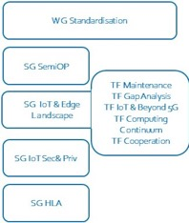
AIOTI WG Standardisation Highlights (1)
Leadership:
Chair: Georgios Karagiannis (Huawei);
Co-chair: Antonio Kung (Trialog)
Mission: AIOTI WG Standardisation is to be recognized as a major contributor to the worldwide interoperability, security, privacy and safety of IoT and Edge Computing systems and applications, and particularly for the development of the market in Europe
Task Forces:
IoT Landscape Georgios Karagiannis (Huawei)
  IoT Landscape maintenance - Georgios Karagiannis (Huawei), Tom de Block (Navigio) is key to keep the liaisons alive and maintain dialogue on how to foster collaboration to improve interoperability & security, v2.9 published in October 2019, new version focusing on edge computing gap analysis, published in September 2021
  Gap Analysis and recommendations - Michelle Wetterwald (FBConsulting) 1st release published May 2018, 2nd release published in January 2020, new version focusing on edge computing gap analysis to be published by the end of 2021
  Cooperation with SDOs/Alliances - to foster co-creation and interworking Georgios Karagiannis (Huawei) (e.g., Liaisons: 3GPP, ITU-T, ISO, OSGi Alliance, BBF, 3GPP; MoUs – signed: AII, OSGi Alliance, BDVA, SCI4.0, ISO/IEC JTC1 SC41, EU-OS, under discussion OPC Foundation
  IoT relation and impact on 5G - Thomas Klein (IBM) ; Georgios Karagiannis (Huawei), 1st release published in June 2018, 2nd in March 2019, 3rd release published on 3rd of May 2020, new version focusing on Beyond 5G, published in September 2021
  Computing Continuum - Ronald Freund (Fraunhofer), report to be published in 2021

Slide 7
AIOTI WG Standardisation Highlights (2)
Task Forces (cont)
HLA / High Level Architecture - Marco Carugi (Huawei), Omar Elloumi (Nokia) 4th release published in June 2018, 5th release published in December 2020
  IoT Reference Architecture and its mapping with existing IoT Reference Architectures
  IoT identifiers - Juergen Heiles (Siemens), 1st release published February 2018
  Guidance for the Integration of IoT and Edge in Data Spaces- Antonio Kung (Trialog), to be published in 2021
SemIoP IoT Semantic Interoperability Martin Bauer (NEC lab), Laura Daniele (TNO) two JWP on semantic interoperability published in October 2019, Semantic Tutorial provided at the IoT Week 2021 on 2 September
IoT Privacy (with WG Policy) Arthur van der Wees (Arthurs Legal)
  IoT Platform, experimentation, LSPs recommendations on concrete standard framework & references to enable ”IoT Trust” and IoT “Privacy by design” + STF 547
IoT Security (with WG Policy) Arthur van der Wees (Arthurs Legal), Jacques Kruse-Brandao (SGS), Harm Arendshorst (iLabs)
  IoT Security Architecture for Trusted IoT Devices; Baseline Requirements for Security & Privacy up to segment requirements; experimentation, LSPs recommendations on concrete standard framework & references to enable ”IoT Trust” based on IoT “Security by design” + STF 547
  AIOTI WG Standardisation deliverables: https://aioti.eu/standardisation

Slide 8
Goal and Content of the Report
Published on 9 September the report: “IoT and Edge Computing impact on Beyond 5G: enabling technologies and challenges Release 1.0”, see: https://aioti.eu/wp-content/uploads/2021/10/AIOTI-Beyond-5G-R1-Report-Published.pdf
The main objectives of this report is to present:
  (1) the IoT and edge computing use cases and the requirements that they are imposing on (beyond) 5G infrastructures;
  (2) (beyond) 5G emerging technologies and challenges
Method of collecting information:
    Using template
    Input provided discussed and approved by AIOTI members

Slide 9
Recommendations – Emerging Topics
Digital Twin (DT)
Deep Edge, Terminal and IoT Device Integration in B5G communication infrastructure
Edge, Mobile Edge Computing and Processing
Network and Server security for edge and IoT
Plug and Play Integrated Satellite and Terrestrial Networks
Autonomous and Hyper-connected On-demand Urban Transportation
Opportunities for IoT Components and Devices
EU legislative framework
Introduces relevant IoT and edge computing use cases and describes possible requirements on an underlying 5G and Beyond 5G communication infrastructure
Introduces Emerging topics in the context of the Beyond 5G communication infrastructure, relevant for IoT and edge computing use cases are identified.

Slide 10
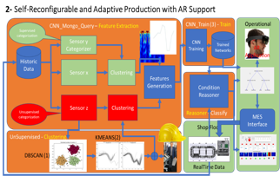
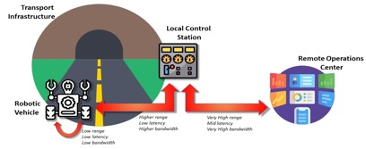
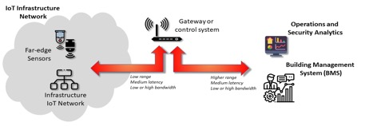
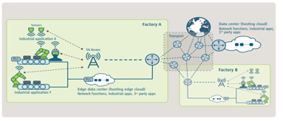
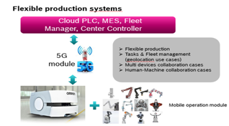
Recommendations – Example Use Cases
Robotic automation
Digital Twin: Condition Management and AR Support Scenario
Critical Infrastructure support applications
5G-enabled smart factory scenario
5G Applied to industrial production systems
Early Earthquake Warning (EEW) system

Slide 11
Recommendations – Reference requirements values
Key conclusion:
  Analysing requirements derived from presented use cases, it can be concluded that the requirements listed in NetWorld Europe SRIA report, cover needs that each of these use cases impose on the underlying 5G and Beyond 5G infrastructure
Source NetWorld Europe SRIA: Selected KPIs Forecast for Terrestrial Radio Communications during the short, medium, and long -term evolution of 5G NR

Slide 12
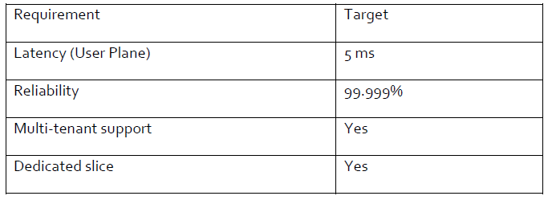
Recommendations – Example Derived Requirements
Use case: Factory of the Future (Section 2.7) – Source 5G-ACIA
Use case: Smart City Edge and Lamppost IoT deployment (Section 2.4) – Radio specific requirements
Use case: Smart City Edge and Lamppost IoT deployment (Section 2.4) – Other requirements

Slide 13
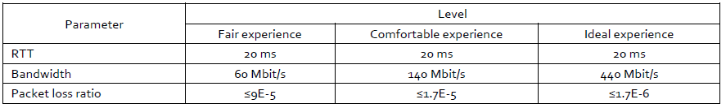
Recommendations – Example Derived Requirements
Use case: Quality of service assurance-related requirements and framework for virtual reality delivery using mobile edge computing supported by IMT-2020 (Section 2.2) - RTT, Bandwidth and Packet Loss for Weak-interaction VR, copied from ITU-T SG13 Y.3109
Use case: Quality of service assurance-related requirements and framework for virtual reality delivery using mobile edge computing supported by IMT-2020RTT (Section 2.2) - RTT, Bandwidth and Packet Loss for Strong-interaction VR, copied form ITU-T SG13 Y.3109
Note:
weak interaction: users can explore the scene by turning their head; however, they do not interact with the objects present in the scene. (VR theatre)
strong-interaction :users can interact with these virtual environments through interactive entities (e.g., controllers) in addition to HMD (Head Mounted Display) head tracking (VR gaming)

Slide 14
Next Steps
Goal of this event is to promote the key results documented in the “IoT and Edge Computing impact on Beyond 5G: enabling technologies and challenges Release 1.0”
Possible questions to the audience:
  Is this report useful for your community?
    If yes, we can have one-to-one meetings to discuss details on topics interesting for your community
  Are there any IoT and edge computing use cases known to your community that need to be included in a subsequent Release?
    If yes, we can have one-to-one meetings to discuss the way on how this input can be provided to AIOTI
Open Discussion

Slide 15
5G enabled Digital Twin
An experience @ Industry 4.0 Lab
Giacomo Tavola
Politecnico di Milano – Industry 4.0 Lab

Slide 16

Hello!
I am Giacomo Tavola.
Department of Engineering, Economics and Management – Politecnico di Milano
Professor of Design and Management of Production Systems
Industry 4.0 LAB Technology Counselor.

Slide 17

OUR COMMUNITY (2019/20 DATA)
OVER 46,000
MSc and BSc students
1,430
Lecturers
1,375
PhD students
403
Full Professors
994
Research Fellows
635
Associate Professors
1,232
Technical/Administrative Staff
392
Researchers

Slide 18
Manufacturing Group @ School of Management
6 Professors – 50 Researchers
Research Areas
Energy and Resource Efficiency in Manufacturing
Product Lifecycle
Management
Asset Lifecycle
Management
Social Sustainable Manufacturing
Manufacturing
Services
Smart
Manufacturing
Education
in Manufacturing

Slide 19

Industry 4.0 Lab
Use case location

Slide 20

I4.0 LAB @SOM
A teaching factory lab for the new manufacturing paradigm
Politecnico di Milano – School of management
Walter Quadrini – walter.quadrini@polimi.it
Giacomo Tavola – giacomo.tavola@polimi.it

Slide 21
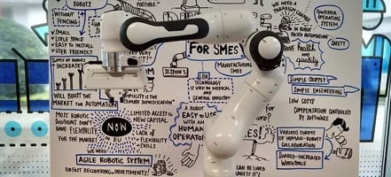
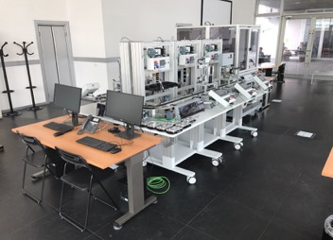
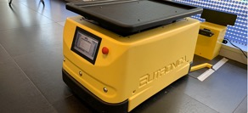
Equipment and key features
Equipment:
6 automated workstation (assembly, drilling, visual inspection, manual) line
1 Robotized cell for assembly and control
1 AGV for material handling
1 cobot for cooperative operations
Key features:
Production planning, scheduling, monitoring and control system (Manufacturing Execution System)
Highly reconfigurable production system
Tracking systems (RFID, QRCode, BarCode) and sensors for production and energy monitoring
Full operational and energy data transparency
Plant and production design and simulation
OPC-UA architecture based field devices
"Open" architecture for the integration of software and hardware components
Augmented Reality functions and Advanced HMI

Slide 22














Some ONGOING and PAST PROJECTS

Slide 23

5G experimentation project
UC31 Industry and Manufacturing

Slide 24
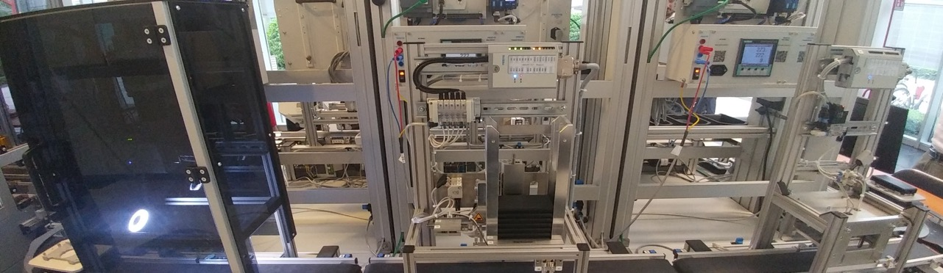
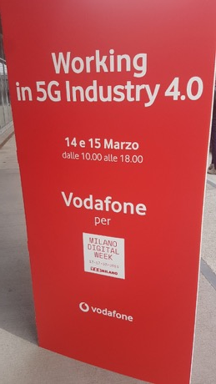

Preliminary project for the realization of 5G Pre-Commercial Trials in the 3.6 - 3.8 GHz spectrum portion (MiSE Notice of 16/03/2017) - Area 1: Milan metropolitan area
Use case 31 - Automation of industrial processes and remote control on cloud for Industry 4.0

Slide 25
Key Performance indicators
 | Service Type | NGMN Requirements | Use Case Requirements
Thoughput | Ultra-high reliability and Ultra-low latency | DL:<= 10 MBps UL:<=10MBps | DL:<= 10 MBps UL:<=10MBps
Latency |  | 1ms | <2ms
Connectivity Density |  | Not Critical | Not Relevant
Traffic Density |  | High | Not Relevant
Reliability |  | High (~99.9999%) | High
Slicing |  |  | Necessary for low latency local management of control applications on top of machinery and for Augmented Reality Applications
MEC (Multiaccess Edge Computing
Spectrum Utilization | Use case requires 5G New Radio network in Band 43 and Slicing availability to manage locally and with low latency machinery control and augmented reality services

Slide 26

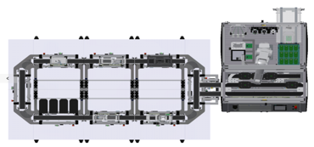

UC31 Concept
Machine Learning for Maintenance
Global IoT (mMTC)
Global 5G
Local IoT – Edge IoT (URLLC)
Local 5G Slice
Notes:
Banda Ultra- Larga (eMBB)
Massive MIMO
Multiconnectivity
Video UHD finalizzati non solo all’entertainment, ma anche ad applicazioni di Realtà Aumentata e Realtà Virtuale
È necessario disporre di uno spettro sempre più ampio (l’industria per questo inizia a concentrarsi maggiormente non solo sulle bande di frequenza oltre i 2 GHz, ma anche oltre i 6 GHz) e sarà necessario andare a migliorare sempre più l’efficienza spettrale, per massimizzare i bit trasportati su ciascuno Hz dello spettro (e di conseguenza abbattere i costi per bit trasportato)
Altissima affidabilità (URLLC)
1 msec radio
Comunicazioni tra autoveicoli Applicazioni di controllo remoto di droni o robot Applicazioni di Realtà Virtuale Automotive Controllo da remoto Un ritardo nell’invio di un comando potrebbe portare ad un incidente con conseguenze anche gravi o far avvertire all’utente un disagio definito in letteratura come “cybersickness”. Si pensi ad applicazioni mediche, dove la perdita di parte dell’informazione anche solo di un singolo sensore potrebbe essere critica nella diagnosi remota di un paziente
Numero indefinito di utenti (m-MTC)
Slim radio
M2M industriale “Smart City” eHealth Alta penetrazione indoor Minimo o “trascurabile” consumo di batteria questo trova applicazione, oltre all’ambito

Slide 27
UC 31 Key Features
Field Data Collection
Condition Recognition
Production process reconfiguration
Supported Maintenance
Trends and system evolution
5G Sensor Connection
5G Edge Computing capabilities

Slide 28
UC31 Application scenarios
Advanced Maintenance Execution System (a-b-c)
Massive data collection feeding:
  an asset management system able to estimate future working trends (e.g. RUL – Residual Useful Life)
  a preventive/predictive maintenance system able to support operators intervention and
Self-Reconfigurable and Adaptive Production Systems (a-d-e)
CNN (Convolutional Neural Network) based machine learning algorithms identifying:
  Specific operational conditions detection and
  Production process reconfiguration or production re-scheduling to optimize performances
Notes:
Use case 1: Advanced Maintenance Execution System
The almost 100% availability of systems is a fundamental requirement of Industry 4.0. An Advanced Maintenance Execution System aims to significantly reduce maintenance costs and plant downtime, minimizing the risk of accidental breakage and induced costs by implementing the Preventive Maintenance paradigm based on the following pillars:
1. Cyclical Preventive Maintenance: is performed based on pre-established cycles of use of the assets and monitored in reality. Also called Time-Based Maintenance is a type of scheduled maintenance that is performed in accordance with a set time interval and in which the time frame is expressed according to the most appropriate use cycles.
2. Condition Preventative Maintenance (Condition Based Maintenance): it is a preventive maintenance that is performed based on the achievement of a predetermined limit value of a measurement (for example, consumption of a bushing or contaminants in the lubricant).
3. Predictive Maintenance, in turn, is a further refinement of the maintenance based on the condition of the equipment and is carried out following the detection and measurement of one or more parameters (eg. The vibration frequency of the rotating machinery) and the subsequent extrapolation or correlation based on an appropriate model of the expected residual life before the failure. Predictive Maintenance is often identified as a sophistication of CBM or as the last step in decision-making in a CBM program, identified as a prognostic activity.
4. Efficient and just-in-time management of the warehouse of spare parts for machinery and consumables.
5. Easy access to specialist documentation and skills, allowing employees
(even non-experts) to be able to work with the necessary speed and accuracy, thanks to remote support or support provided by expert systems and advanced trouble-shooting techniques
Use Case 2: Self-Reconfigurable and Adaptive Production Systems
Today's European manufacturing industry is challenged by conditions, constraints and goals that they change faster and faster, informed decisions must be taken more and more in time short. Production strategies, processes and product characteristics must evolve to keep the pace of a market where customer expectations and competitive pressure do not allow any uncertainty. On the other hand, application systems are very often made up of isolated monolithic blocks and not easily adaptable to the new conditions. At the same time, the productive resources (equipment, processes, goods, products and materials, operators) are not connected in a network or connected in a static and hierarchical way, in which each component is not aware of the surrounding context and of the global objectives of the production system.
The challenge that the case of use wants to face is the experimentation of technologies and methods for the automatic reconfiguration of production systems locally using theirs flexibility features and the 5G enabling technology for interconnection

Slide 29
Physical Architecture

Slide 30

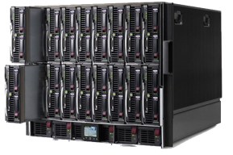


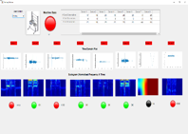
Physical Layout – 5G Connection
MEC Edge Computing
Sensors
5G router
I40Lab Servers
Lab Local Network
5G Network
Wearable
Plant
Local Devices

Slide 31

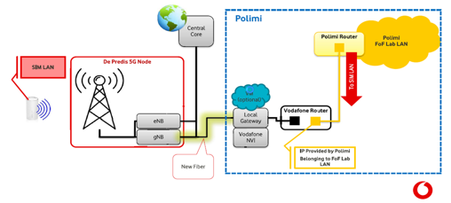


Phase 2 - Network Configuration WITH 5G
Cloud/Edge/MEC
I40Lab Servers
VM1
VM2
VM3
VM4
Shared
Repository
MES INTERFACE
FORMATTER
REASONER
mongo
DB
ANDON
MQTT BROKER
Sensors
MONGO
Query
CNN_Train
5G communication infrastructure
Weareables and Portable Devices
Plant
Weareables and Portable Devices

Slide 32
Application Architecture

Slide 33
1-Advanced Maintenance Execution System
Historical data collection in MongoDB
Maintenance data analysis
Degradation model creation
Run Time data capture and model projection (Reasoner-Maintenance)
Maintenance Andon (local and http)
Edge based maintenance request generation

Slide 34
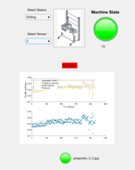

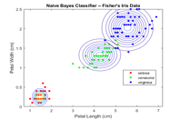

1-Advanced Maintenance Execution System
Feature Extraction - Model Generation
Reasoner - Classify
Operational
Historical
Data
Features Extraction
(RMS, …)
Naive Bayes Prediction Model generation
Model
RUL Reasoner
RealTime
Data
Notes:
[1] Manning, C. D., P. Raghavan, and M. Schütze. Introduction to Information Retrieval, NY: Cambridge University Press, 2008.

Slide 35
2- Self-Reconfigurable and Adaptive Production
Historical data collection in MongoDB
Operational data analysis
Convulational Neural Network training
Run Time data capture and condition detection (Reasoner)
Condition Andon (local and http)
Condition signaling
Production plan modification
Certified Production Data

Slide 36

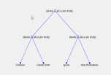

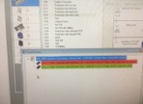
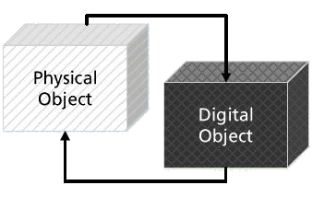
2- Self-Reconfigurable and Adaptive Production – Real Time
Shop Floor
Server/Edge/Cloud
Operational
RealTime
Data
MQTT Data Bus
Condition
MQTT Data Bus
AR
Application
RaspPi
Collector
Condition Reasoner
JSON
Andon
Reaction
MES
Interface
Trained
Networks
MES
Perception
Cognition
Reaction
Notes:
Ester, M., H. P. Kriegel, J. Sander, and X. Xu, “A Density-Based Algorithm for Discovering Clusters in Large Spatial Databases with Noise”. In: Proceedings of the 2nd International Conference on Knowledge Discovery and Data Mining,
(2) “k-means++: The advantages of careful seeding” Arthur, David, and Sergei Vassilvitskii, Proceedings of the eighteenth annual ACM-SIAM symposium on Discrete algorithms, Society for Industrial and Applied Mathematics (2007)
https://it.mathworks.com/help/deeplearning/examples/classify-image-using-googlenet.html

Slide 37
Results

Slide 38
Results
Enable existing production systems to produce at least 50% smaller batches and at least 50% more product variations on average cost-effectively, whereby production will be demand-driven and waste will be significantly reduced. System does not preclude the possibility of carrying out unit batch production with complete tracking at the level of a single piece produced of all the parameters detected during the production phase.
Reduction of at least 30% of installation and set-up time and costs for existing production systems leading to a significant increase in production capacity.
The implementation of the solution is estimated to take approximately 1 hour for the installation, configuration and testing of each single detection point, including the connection on the 5G infrastructure
Reduction of average energy consumption by 5% through optimized use of production capacity.
The estimated energy savings taking into account the increase in availability components according to the OEE (Overall Equipment Effectiveness) methodology is 15%
Reduction of blocking failures by 50%
Without prejudice to the considerations on the significance of the test environment implemented at the Industry 4.0 Lab, the recognition of the conditions leading to blocking failures was 80% effective, while the punctual recognition of failure situations was greater than 95 % with 12% false positives.

Slide 39
Requirements
Functional requirements
  MEC (Edge Computing) infrastructure required to provide operational environment for Computer Intensive application as model creation/update, features extraction, forecast calculation.
  As most of the activities are indoor in possibly harsh conditions, it is required a careful analysis of propagation and signal interference
Non-functional requirements
  Reliability of communications considering environment conditions (electromagnetic interferences or signal reflection or Faraday effect)
  Security and privacy is required to safeguard private and sensitive production data. Non repudiation mechanisms need to be implemented. Private networks or sliced are key enablers

Slide 40
AIOTI WG Standardisation: Edge Computing Standard Framework Concepts - Release 1.0
27 October 2021

Slide 41
Goal and Content of the Report
Published on 7 September 2021 with title: “Edge Computing Standard Framework Concepts, Release 1”, see: https://aioti.eu/wp-content/uploads/2021/09/AIOTI-SDOs_alliance_landscape_edge_computing_standard_framework_R1-Published.pdf
  Goal of report:
    The main objective of this deliverable is to briefly present the global dynamics and landscapes of edge computing SDO, Alliance and OSS initiatives, which can be used: 1) to leverage on existing edge computing standardization, industry promotion and implementation of standards and protocols, and 2) to provide input to edge computing standardisation gap analysis activities
  Method of collecting information:
    Using template
    Input provided discussed and approved by AIOTI members
  Table of contents:
    Executive Summary
    1. Goal and motivation
    2. Edge Computing SDO and Alliance Initiatives Landscape
    3. Edge Computing Open Source Software Initiatives Landscape
    Appendix 1: Edge Computing SDOs, Alliances and OSSs

Slide 42
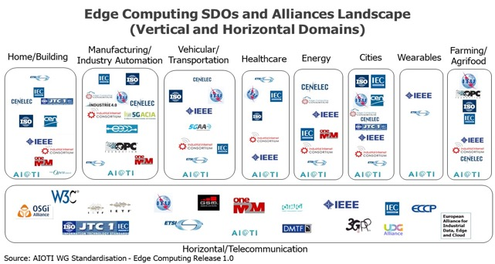
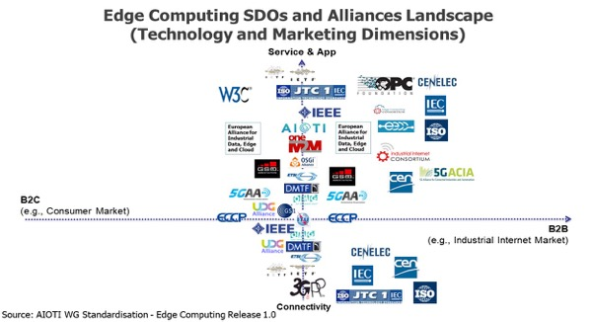
Edge Computing SDO and Alliance Initiatives Landscape

Slide 43
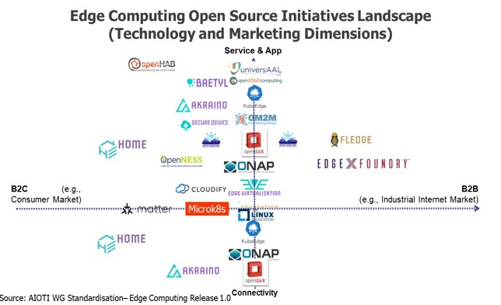
Edge Computing Open Source Software Initiatives Landscape

Slide 44
Next Steps
Goal of this event is to promote the key results documented in the “Edge Computing Standard Framework Concepts, Release 1”
Possible questions to the audience:
  Is this report useful for your community?
    If yes, we can have one-to-one meetings to discuss details on topics interesting for your community
  Are there any SDO/Alliance/OSS initiatives working on edge computing known to your community that need to be included in a subsequent Release?
    If yes, we can have one-to-one meetings to discuss the way on how this input can be provided to AIOTI
Open Discussion

Slide 45
ETSI TC MTS Contribution to
Testing in IoT and Edge Computing
Axel Rennoch, Sascha Hackel
Fraunhofer FOKUS, Berlin

Slide 46
ETSI TC MTS Motivation
IoT and Edge computing communication protocol and configuration requires especially high quality and confidence in the implementations.
This applies for any test activities/scenarios, including functional conformance, interoperability scenarios or non-functional testing types (like robustness/security or performance).
Testing methods and techniques should follow standardized approaches (as e.g. for mobile communication).

Slide 47
ETSI TC MTS Vision
Edge computing technologies and standards should be accompanied by corresponding unique definitions of test scenarios and catalogues (using standardized and well-known specification techniques).
Certification has to be based on standardized test catalogues and implementations using e.g. ETSI test languages (TDL and TTCN-3).
Samples are provided in AIOTI Report, Section 4.2.4

Slide 48
What do we have?
In AIOTI
Edge Computing Standard Framework Concepts Release 1.0

Slide 49







Existing QA/Testing Approaches
Standardized Test purposes
    Used in multiple domains:
    e.g. mobile, access/core networks, ITS, IoT
    Test types, e.g. conformance, interop, security
Advanced testing technology:
    Used for certification:
    e.g. UMTS, LTE, 5G, oneM2M
Qualified IoT-Testware (code):
    Executable with open source or
    commercial TTCN-3 tools

Slide 50
Initial Working Results (AIOTI report)
ETSI committee on Methods for Testing and Specifications (MTS) completed a first set of test specification standards:
  CoAP conformance, security and performance (TS 103596)
  MQTT conformance, security and performance (TS 103597)
  Foundational Security IoT-Profile by IEC 62443 (TS 103646)
Please refer to ETSI: MTS Test specifications for IoT:
www.etsi.org/standards/getstandards#page=1&TB=860&sort=3
Notes:
These new standards fill the gaps for the quality assessment of some of the most relevant communication protocols and system requirements of today’s industrial IoT systems using standardized testing techniques defined by ETSI.

Slide 51
What we do have to consider?
For AIOTI
Edge Computing Standard Framework Concepts Release 1.x

Slide 52
Specific IoT and Edge Aspects for Testing
  Distributed, heterogeneous architectures and interfaces
    Interoperability and Security requirements
    Multiple vendor devices/platforms
    Domains specific applications, objects and functions (under test), use cases
    Synergies and reusability of test harness from different verticals?
  Management at the edge (nodes)
    Mobility of devices
    Elasticity and fluctuation of data workload (container/kubernetes pods etc.)
    Provisioning, orchestration and coordination (deterministic capabilities, SDN)
  Performance/resource restrictions at IoT layer
    Big amount of devices (capacity and scalability)
    Ultra-low latency (≈ ms) is critical for real-time type of application
    Limited connectivity and power consumption (limited autonomy)

Slide 53
Challenges for IoT and Edge Testing
  Distributed, heterogeneous architectures and interfaces: Scope / Testing types for EC
    Conformance and Security (before commissioning safety-critical systems)
    The human element must be considered in all aspects of safety
    Interoperability
    Performance, real-time aspects
  Management at the edge (nodes): Systematic Test definition/specification
    Test suite structuring: Test configurations; Implementation under test roles (server/client)
    Test objectives (test purpose catalogs)
    Use case scenarios (test case implementation)
  Performance/resource restrictions at IoT layer: Testbed and software architecture (test tools)
    Demonstrate readiness of domain-specific solutions
    Certification

Slide 54
Summary
Testing/QA is important
Very good standardized methods and techniques
Standardization is key for certification
More specific challenges for IoT and Edge computing

