Slide 1

Presentation of the Report on IoT and Edge Computing Carbon Footprint Measurement Methodology R2
Webinar • 7 February 2024

Slide 2
Opening and Welcome
Georgios Karagiannis, WG Chair (Huawei)

Slide 3
Agenda

Slide 4
Agenda
15.00 Opening and Welcome (5 min)
Georgios Karagiannis, WG Chair
15.05 Presentation of the report and recommendations (15 min)
Georgios Karagiannis, WG Chair
15.20 Presentation of the use cases (50 min)
    "Remote monitoring of screw connection of wind turbines – Analysis of the potential CO2 emission reduction with a smart ICT solution in wind power plants”
    Sylvie Couronné, Fraunhofer IIS
    iSeeIce: sensors for better winter maintenance
    Lizhen Huang, NTNU
16.10 Questions from the audience (10 min)
Moderated by Georgios Karagiannis, WG Chair
16.25 Wrap up and end of the Webinar (5 min)
Georgios Karagiannis, WG Chair

Slide 5
About AIOTI WG ICT for CO2 Reduction Measurement Methodologies (ICM)

Slide 6


AIOTI WG ICT for CO2 Reduction Measurement Methodologies (ICM)
Chair
Georgios Karagiannis
Huawei
Co-Chair
Francesca Poggiali
GS1
Vision: To ensure IoT and Edge computing contribution to the achieving goals of the Green Deal are recognised and included in relevant EU policies
Scope: Define the value of using IoT and edge computing in supporting Green Deal policies

Slide 7
Highlights
Relevant facts
70 member organisations
93 participants
Main achievements
Deliverables | Collaborations | Events
Methodology to measure CO2 reduction – 2 releases (2022, 2023) AIOTI input to the European ICT Standardisation Rolling Plan (2022, 2023) Contribution to the Annual Union Work Programme (2023) Public consultation report 2022 Strategic Foresight Report (2022) Public consultation response Carbon Removal Certificates (2022) Blog: IoT and Edge Computing impact on Green Deal (2022) IoT and Edge Computing impact on Green Deal (2021) | EGDC: providing input GeSI/Digital with purpose ITU-T SG5 and ETSI TC EE (cooperation on aligning with ITU-T SG5 L.1480 - revised version) | IoT Week 2022 ETSI IoT Week 2022 & 2023 AIOTI Signature Event 2022 & 2023 MWC roundtable 2023 Digital with purpose Global Summit 2023 IEEE World Forum on IoT 2023

Slide 8
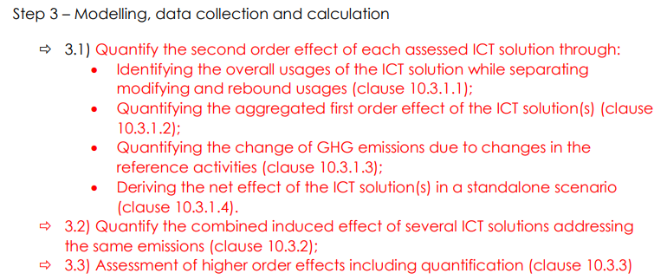
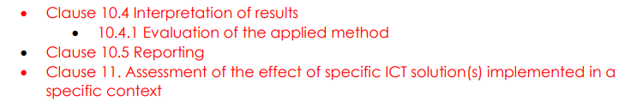
WG ICM Priorities: 2024 Work Plan
Update of the CO2 footprint methodology report (Sept 2023): avoided emissions, recycling (and reuse tbd), testing
Cooperation between AIOTI with ITU-T SG5 and ETSI TC EE on aligning with revisions that ITU-T SG5 and ETSI TC EE are doing on future updates of: L.1480: “Enabling the Net Zero transition: Assessing how the use of information and communication technology solutions impact greenhouse gas emissions of other sectors”
  Possible input from AIOTI to revised ITU-T L.1480:

Slide 9
Presentation of the Report and Recommendations
Georgios Karagiannis, WG Chair (Huawei)

Slide 10
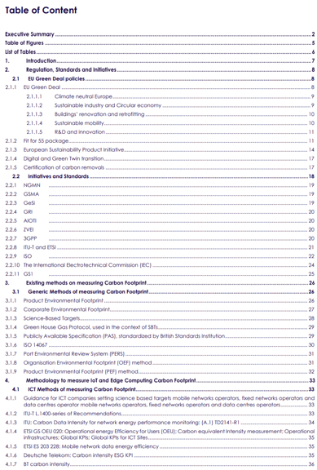
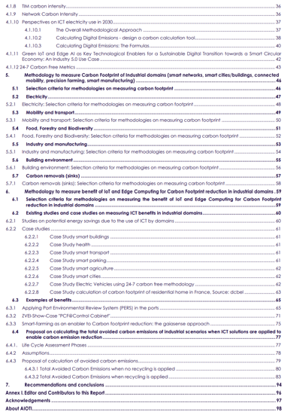
Table of Content: Key Updates
Scope
This Report focused on (1) providing guidelines and a methodology to IoT and Edge Computing technologies and services stakeholders on making informed choices on how to assess the carbon footprint of solutions and services they use, and to as well (2) to measure how these methodologies support carbon footprint reduction of their use

Slide 11
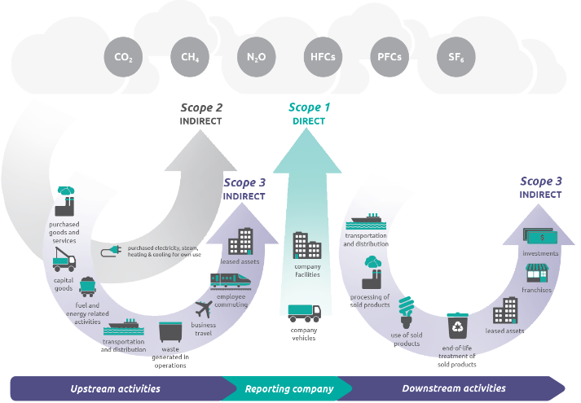
Concepts (Section 3.1.3): Science Based Targets - SBT
Science Based Targets Initiative:
Established in 2015
Sets emission reduction targets in line with Paris Agreement goals
Developed and launched the world's first Net Zero standard
Scope 1 = the emissions from owned or operated assets
Scope 2 = the emissions from purchased energy
Scope 3 = the emissions from everything else (suppliers, distributors, product use, etc.)
Overview of GHG Protocol scopes and emissions across the value chain, Source: GHG Protocol
Notes:
Let me please introduce you now some definitions and methods that allow categorisation and classification of carbon emission sources
First of all SBT and the scopes:
Net Zero standard -> 2050 according to the 1.5 degree climat scenario the balance between carbon emission and carbon removals is achieved
Essentially, scope 1 and 2 are those emissions that are owned or controlled by a company, whereas scope 3 emissions are a consequence of the activities of the company but occur from sources not owned or controlled by it.

Slide 12
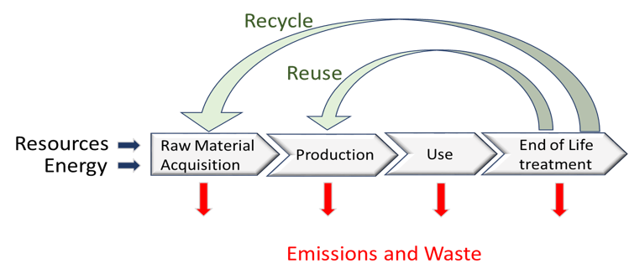
Concepts (Section 6.4.1): Life Cycle Assessment (LCA)
Carbon Footprint measurement method – Scope 3
Life Cycle Phases
LCA phases
1) Goal and Scope
2) LC Inventory Analysis
3) LC Impact Assessment
4) Interpretation of results
ISO Standard 14040/14044
Source: based on Journal of Cleaner Production 277:123741, August 2020, “Circular business models: A review”, DOI:10.1016/j.jclepro.2020.123741
Notes:
Method to describe the different steps in scope 3
It splits the supply chain in 5 or more steps, each step affording itself an own inventory (resources, energy as input but also carbon footprint and waste as output)

Slide 13
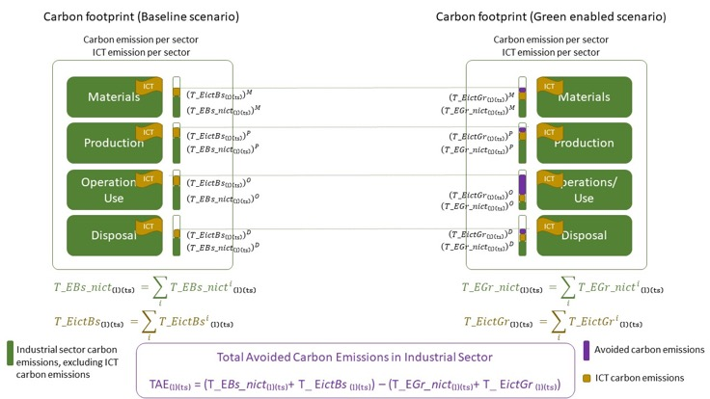
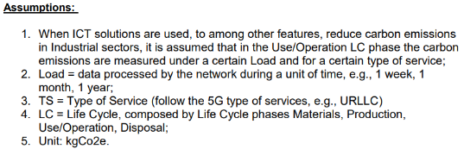
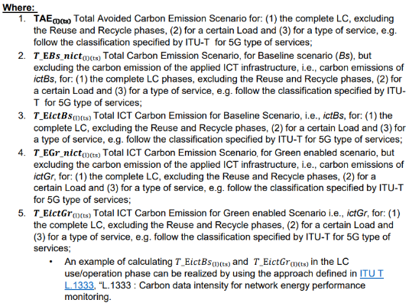

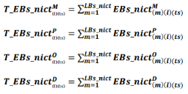
Section 6.4.3.1: AIOTI input on total avoided carbon emissions in vertical sectors, when applying ICT for non recycled products
Source: AIOTI: https://aioti.eu/wp-content/uploads/2023/09/AIOTI-Carbon-Footprint-Methodology-Report-Final-R2.0.pdf

Slide 14
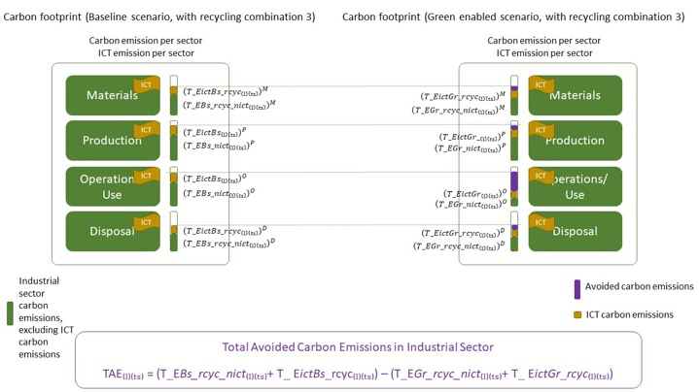
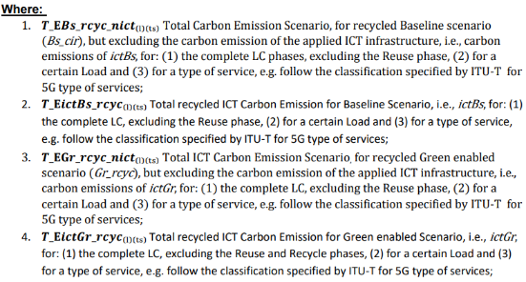
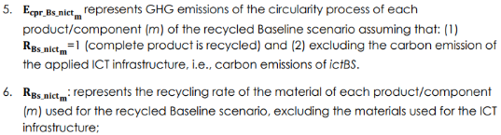

Section 6.4.3.2: AIOTI input on total avoided carbon emissions in vertical sectors, when applying ICT for recycled (with closed loop recycling) products
Source: AIOTI: https://aioti.eu/wp-content/uploads/2023/09/AIOTI-Carbon-Footprint-Methodology-Report-Final-R2.0.pdf

Slide 15
Recommendations and Conclusions
Smart use of clean digital technologies can serve as a key enabler for climate action and environmental sustainability
Technology can improve energy and resource efficiency, facilitate the circular economy, lead to a better allocation of resources; reduce emissions, pollution, biodiversity loss and environmental degradation
The ICT sector must ensure the environmentally sound design and deployment of digital technologies by minimising the ICT (IoT and Edge computing) carbon footprint (e.g., PCF):
  Measurement of the benefits provided by ICT in carbon reduction is a struggle ➔ initiatives as EGDC can help
  Use of standardised connectivity related metrics/parameters related to carbon footprint, in order to be used by stakeholders to compare and evaluate the benefit of different connectivity solutions in reducing the carbon footprint of industrial sectors
  Include scope3 impacts in the CO2e (CO2 equivalent) footprint (e.g., PCF) calculation
Usage of digital technologies (e.g. monitoring and controlling energy usage) for an indirect reduction of greenhouse emissions due to, as an example, manufacturing
An important path to realise carbon reduction is to increase awareness and information for the citizens to reduce energy and carbon footprint and increase the incentives for citizen to realize this reduction
Recycling is not only reducing the dependency on primary raw materials, but it is as well reducing the carbon emissions of products and systems:
  However, important is to distinguish what are the benefits of recycling from the benefits of applying ICT to reduce carbon emissions in industry scenarios,
The definition of an agreed and aligned methodology to measure the total avoided carbon emissions in industry scenarios, when applying ICT, is a key requirement for the success of deploying ICT solutions to reduce carbon emissions in industry scenarios

Slide 16
Next Steps
Investigating the Life Cycle reuse phase and its dependency to other LC phases;
Apply the equation in testbeds, use cases and EC funded projects:
AIOTI WG ICM representative presented the WG key activities to the following AIOTI WGs, including the proposed guidelines to implement the equations that are included in this report in their testbeds and use cases:
  30 November 2023 - Presentation at AIOTI WG Testbed
  19 December 2023 - Presentation at AIOTI WG Mobility
  12 January 2024 - Presentation at AIOTI WG Manufacturing
  18 January 2024 - Presentation at AIOTI WG Energy
  26 January 2024 - Presentation at AIOTI WG Agriculture
  18 January 2024 - Presentation at AIOTI WG Health
On 15 December 2023 the AIOTI WG ICM WG webinar “Future AIOTI steps for calculating carbon emissions in LC phases” took place and where among others CERTH demo has been presented: “Energy consumption & emissions monitoring& assessment platform (ENIGMA)”
Cooperation with ITU-T SG5 and ETSI TC EE and aligning with ITU-T SG5 L.1480, (revised version)

Slide 17
Presentation of the use case
"Remote monitoring of screw connection of wind turbine – Analysis of the potential CO2 emission reduction with a smart ICT solution in wind power plants”
Sylvie Couronné, Fraunhofer IIS

Slide 18

Overview
Overview of the case study
Use case wind energy plant
ICT Infrastructure: Smart Monitoring System
Calculation of the CO2eq footprint of the Smart Monitoring System
Analysis of the potential avoided CO2eq emissions using the Smart Monitoring System
Interpretation and conclusion/next steps

Slide 19
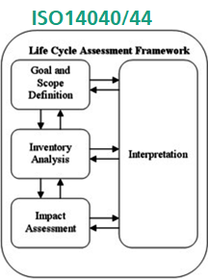
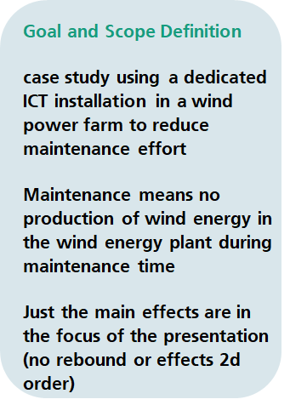
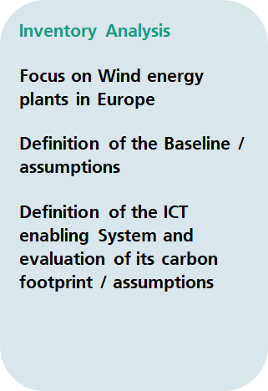
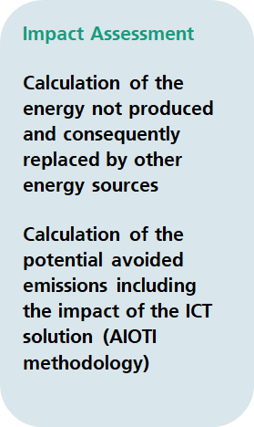
Overview of the case study
Text

Slide 20
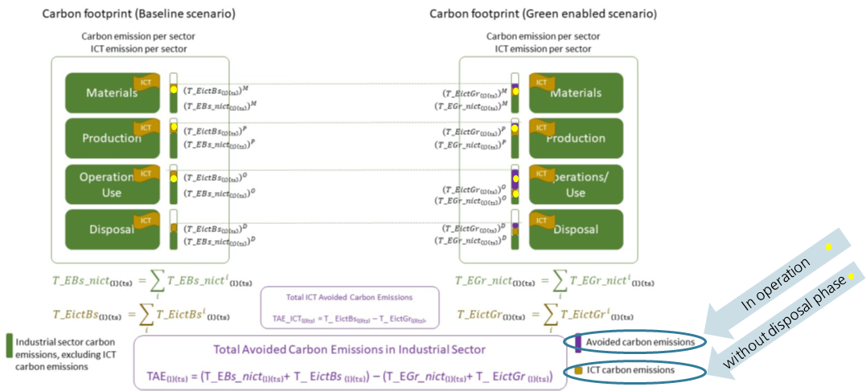
Relation with the CO2 Methodology Report

Slide 21
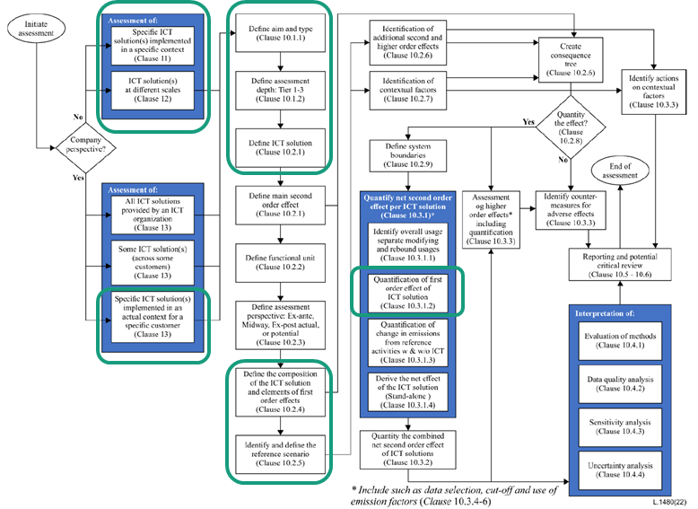
Relation to ITU-T L.1480

Slide 22
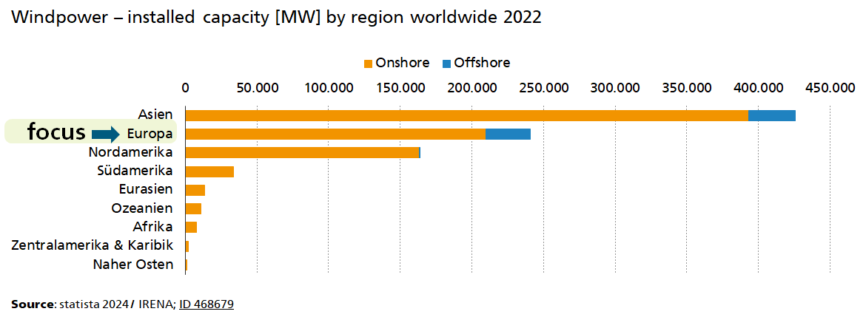
Use case wind energy plants

Slide 23
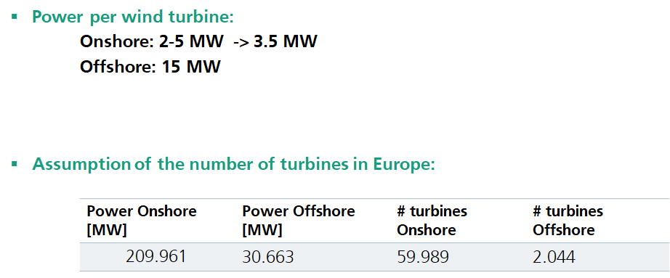
Case study: wind energy plants in Europe

Slide 24
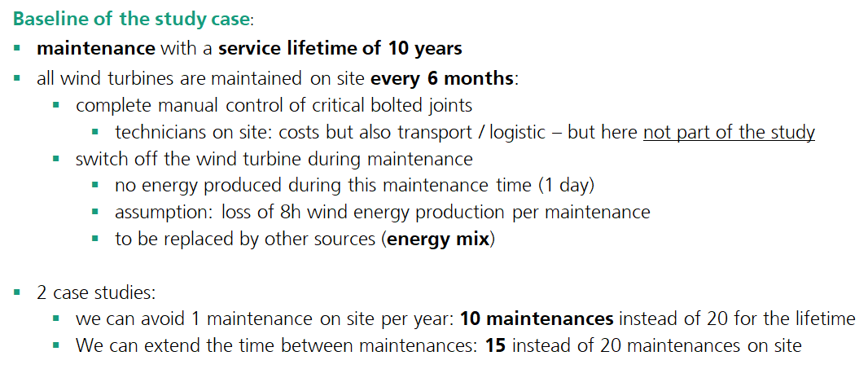
Case study: wind energy plants in Europe
Factors for CO2eq reduction and assumptions

Slide 25
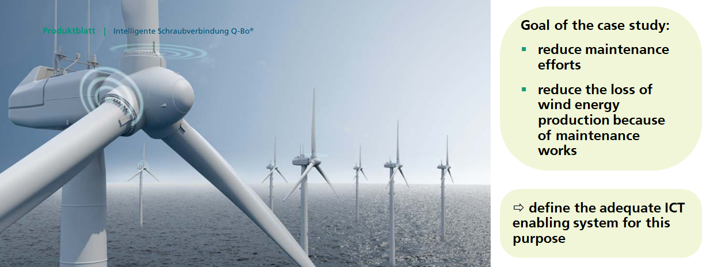
ICT Enabling System: Smart Monitoring System
Smart monitoring of screw connections Q-Bo® with mioty® radiocommunication
Fraunhofer IIS - Q-Bo® Technology

Slide 26
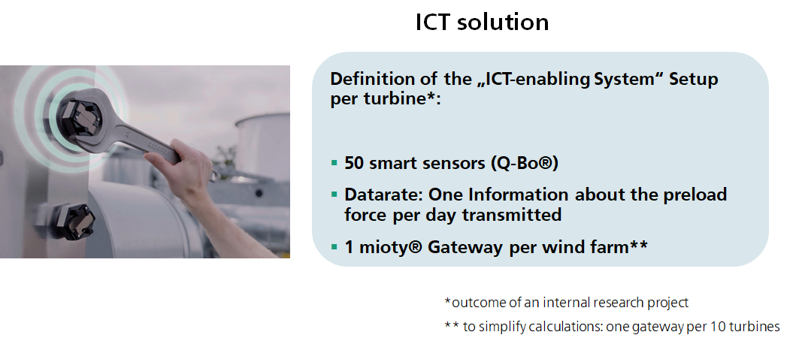
ICT Enabling System: Smart Monitoring System
Smart monitoring of screw connections Q-Bo® with mioty® radiocommunication

Slide 27
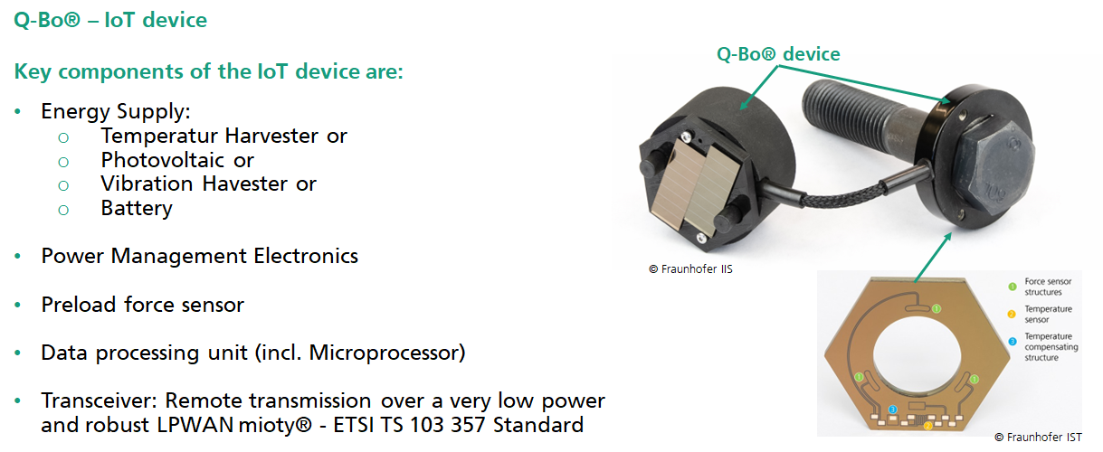
Smart screw monitoring Q-Bo®
wireless and energy self-sufficient monitoring of screw connections

Slide 28

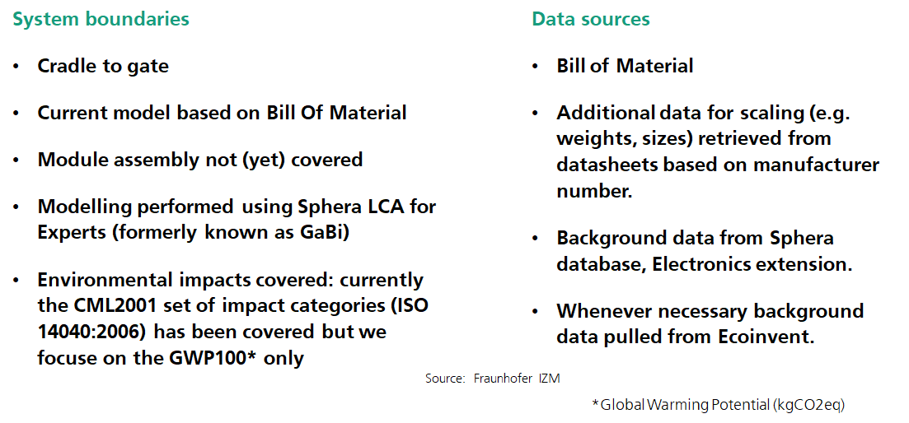
Calculation of the CO2eq footprint of the Smart Monitoring System
Methodology:

Slide 29
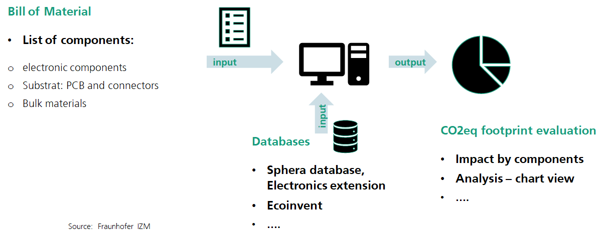
Calculation of the CO2eq footprint of the Smart Monitoring System
Methodology:
Sphera database
Ecoinvent database

Slide 30


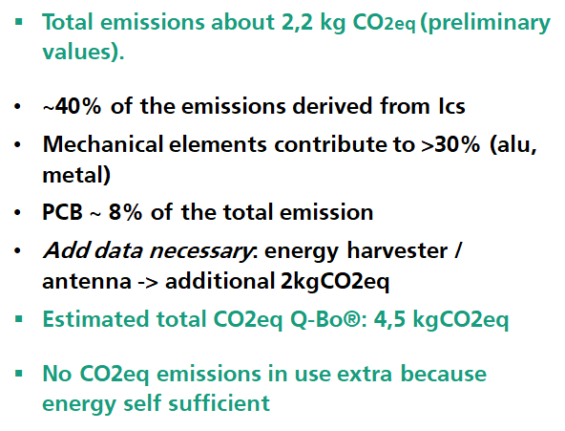
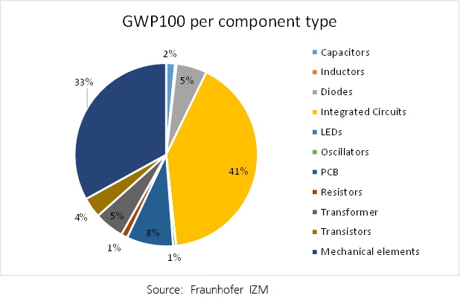
Calculation of the CO2eq footprint of the Smart Monitoring System
Results of one Q-Bo® IoT device

Slide 31
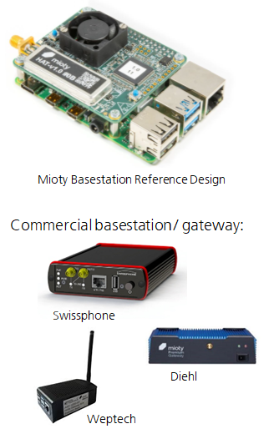
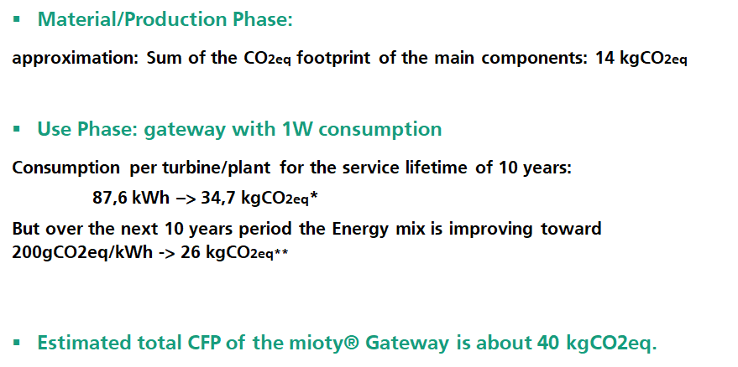

Calculation of the CO2eq footprint of the Smart Monitoring System
Results of the mioty® gateway device

Slide 32
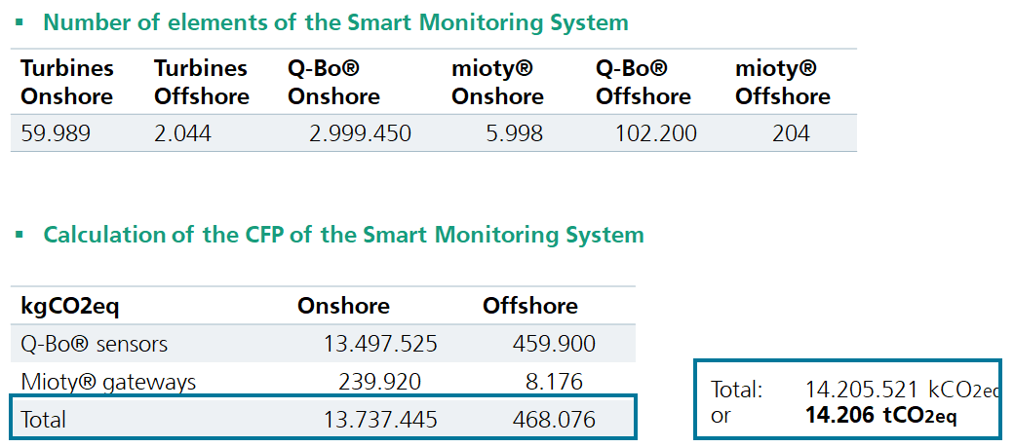
Calculation of the CO2eq footprint of the Smart Monitoring System

Slide 33
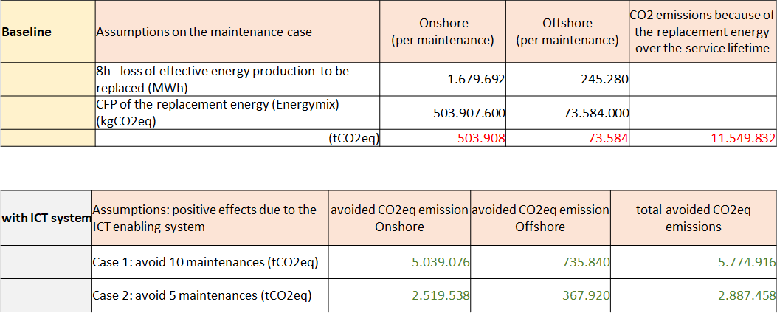
Analysis of the potential avoided CO2eq emissions
Method applied as a "screening approach"
Note: Equation specified by AIOTI, in the “IoT and Edge Computing Carbon Footprint Measurement Methodology R2” report is used in order to derive these calculations ​

Slide 34
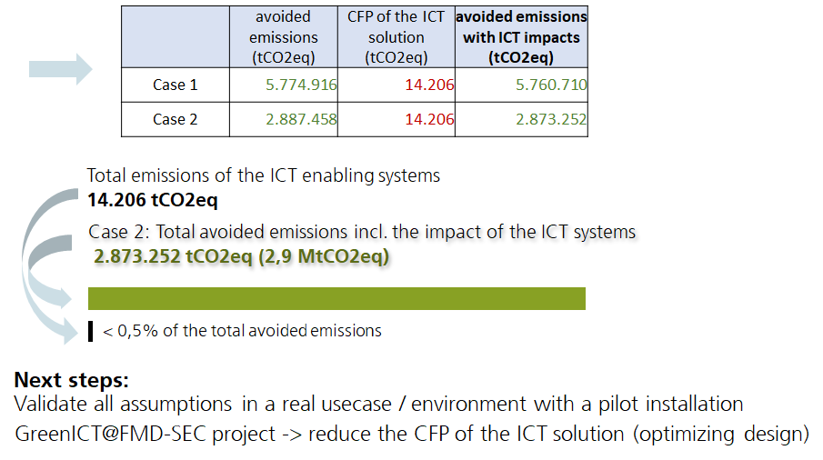
Interpretation and next steps
Summary of the case study

Slide 35

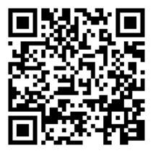
Thank you
Sylvie Couronné
GreenICT
Phone +49 911 58061 3205
sylvie.couronne@iis.fraunhofer.de
Fraunhofer IIS
Nordostpark 84
90411 Nuremberg
Germany
www.fraunhofer.de

Slide 36
Presentation of the use case
iSeeIce: sensors for better winter maintenance
Lizhen Huang, Professor, Leader of Civil engineering and Geomatics group
Norwegian University of Science and Technology (NTNU)

Slide 37

Outline
Background
Life cycle assessment of sensors
Next step

Slide 38
Background

Slide 39




Partners

Slide 40
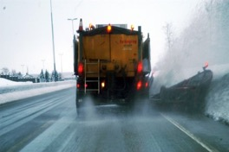
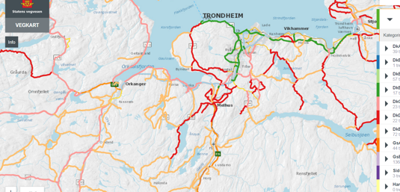
Why we need sensors
Provide information to road users
Provide information to maintenance personnel
Control winter maintenance measures
Decreasing the transport needs on winter maintances and then CO2 emissions
Decreasing the use of salt
Source: SVV. iceIsee report​

Slide 41

Development History of Ice Sensors
Type I (prototype )
Type I
Type II (prototype )
Campus Installation
Snow lab test
Field test
2016
Black ice detection
Mount Wuyi
2016
Black ice detection
Heilongjiang Province & Gjøvik
2017
Black ice, wet & snow
Trondheim Snow Lab
Type II
Type III (prototype)
Type III (under development)
Requirement investigation
Sensor implementation
Laboratory calibration
2017
Black ice, wet & snow
Heilongjiang Province
2018
Black ice, moist, wet & snow
2018
Black ice, moist, wet & snow
Östersund

Slide 42
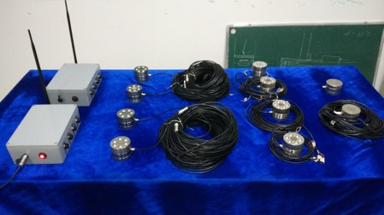
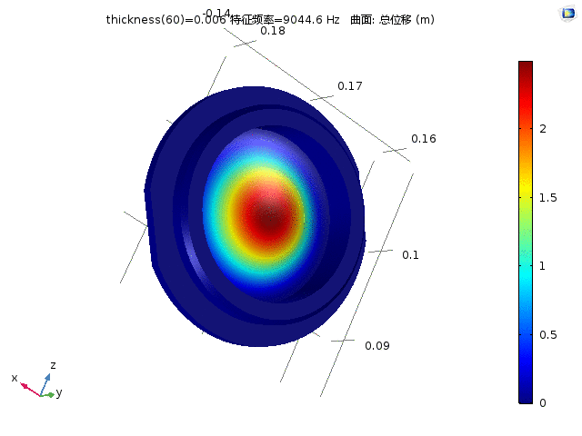
Campus Installation
Installation site: NTNU in Gjøvik
Installation time: 2016.12
Sensor: Type I
Feature: Black ice, WiFi

Slide 43
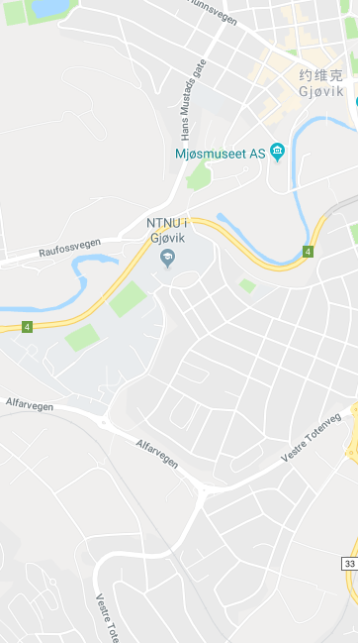
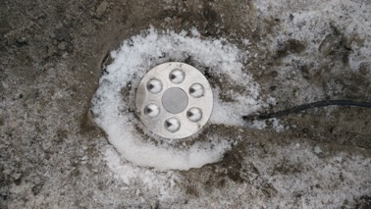
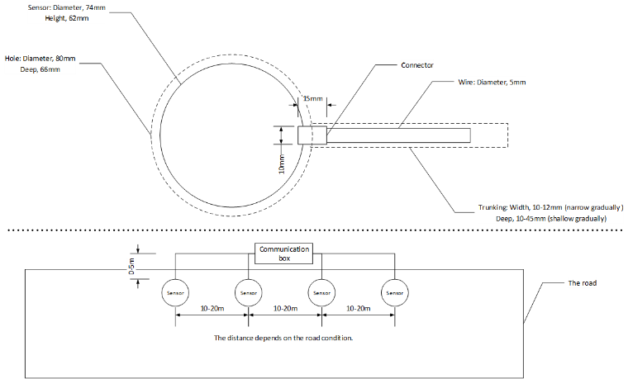
Campus Installation
Installation sketch map

Slide 44
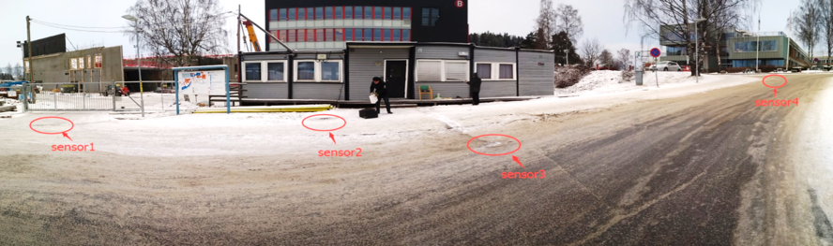
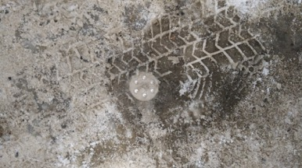
Campus Installation

Slide 45
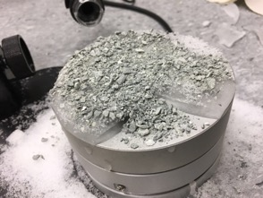
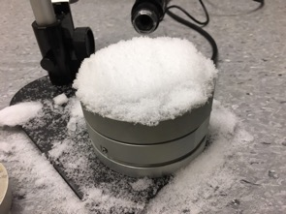
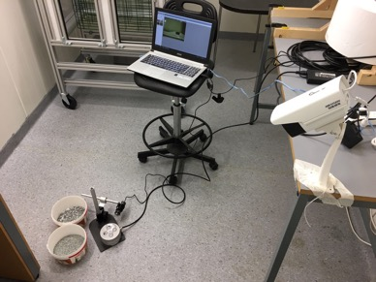
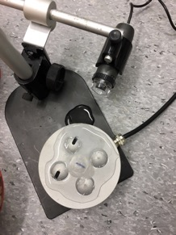
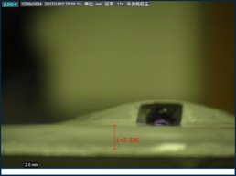
Snow Lab Test
Test content:
  Icing test
  Snow test
  Mixture test
  Salt test

Slide 46
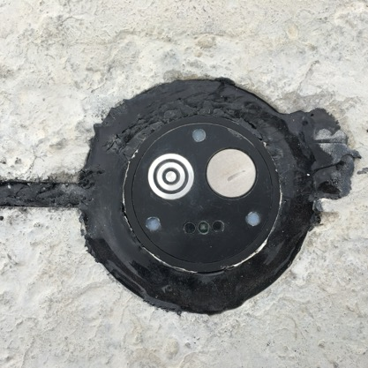

Field Test
Test site: Östersund
Test time: 2018.5
Sensor: Type III(prototypeV2.0)
Feature:
Black Ice, Moist, Wet & Snow, 4G

Slide 47


Field Test

Slide 48

Field Test

Slide 49
Life cycle assessment of sensors

Slide 50
Steps
Generally, a LCA consists of four main activities:
1. Goal definition (ISO 14040):
  The basis and scope of the evaluation are defined.
2. Inventory Analysis (ISO 14041):
  Create a process tree in which all processes from raw material extraction through waste water treatment are mapped out and connected and mass and energy balances are closed (all emissions and consumptions are accounted for).
3. Impact Assessment (ISO 14042):
  Emissions and consumptions are translated into environmental effects. The are environmental effects are grouped and weighted.
4. Improvement Assessment/Interpretation (ISO 14043):
  Areas for improvement are identified.

Slide 51
Framework
Goal and scope definition
Interpretation
Direct application:
Production development and improvement
Strategic planning
Marketing
Other
Inventory analysis
Impact assessment

Slide 52

Life cycle stage (EN 15804:2012 and EN 15978:2011, NS 3720:2018)

Slide 53
Method and data
FU: One unit of sensor to measure black ice, temperature and snow of road surface for 5 years
System boundary: Production and use stage (Cradle to grave)
Data:
  Material and energy: on site collection with producers and user
  Background data: Ecoinvent database
Assessment method:
  The ILCD 2011 Midpoint (EC-JRC Global, equal weighting) method was used to estimate the environmental impacts.

Slide 54
Assumption
Installation and transport from factory to installation place is not included
The transport during production stage is assumed to be global average value
The global average level for material productions
The sensor is used in Norway. Therefore, the energy mix for use stage is following Norwegian situation

Slide 55
Preliminary results without considering circularity and benifit
Equation specified by AIOTI, in the “IoT and Edge Computing Carbon Footprint Measurement Methodology R2” report is used in order to derive these calculations

Slide 56
Next Step
More data on sensors (focus on recycling and reuse)
Information on the benefit/value of sensors for winter maintenance

Slide 57
Thank you
Lizhen Huang, Ph.d
Professor, Leader of civil engineering and geomatics group, Department of manufacturing and civil engineering,
NTNU, M:+47 40380958
E-mail: lizhen.huang@ntnu.no
https://www.ntnu.edu/employees/lizhen.huang
H2020 project: GIFT https://www.gift-h2020.eu/
HEU project: SPADE https://spade-horizon.eu/
HEU project: Precycling https://www.precycling-project.eu/

Slide 58
Questions from the Audience
Moderated by:
Georgios Karagiannis, WG Chair (Huawei)

Slide 59
Wrap up and end of the Webinar
Georgios Karagiannis, WG Chair (Huawei)

Slide 60

Thank you for listening
Any questions?
You can find us at @AIOTI_EU or email sg@aioti.eu

