Slide 1

Presentation of the Edge driven Digital Twins in distributed energy systems:
Role and opportunities for hybrid data driven solutions
Webinar • 19 March 2024

Slide 2
Opening and Welcome
Natalie Samovich, WG Energy Chair (Enercoutim)

Slide 3
Agenda

Slide 4
Agenda
15.00 Opening and Welcome (5 min)
Natalie Samovich, AIOTI WG Energy Chair, Enercoutim
15.05 Presentation of the paper (15 min)
Natalie Samovich, AIOTI WG Energy Chair, Enercoutim
15.20 Presentation of the paper use cases (45 min)
Asbjorn Hovsto, Hafenstrom
Ana Pereira, Ubiwhere
16.05 Presentation of the paper recommendations (15 min)
Mays AL-Naday, University of Essex
Ondrej Cerny, E.DSO
16.20 Questions from the audience (10 min)
16.30 Wrap up and end of Webinar (5 min)
Natalie Samovich, AIOTI WG Energy Chair, Enercoutim

Slide 5
About AIOTI WG Energy

Slide 6


Chair
Natalie Samovich
Enercoutim
WG Energy
Co-Chair
Dolores Ordóñez Martínez
Anysolution
Vision: We enable the development and deployment of the advanced IoT technologies, applications and services creating IoT sustainable, safe, secure and standardised solutions to address the changing paradigm in energy sector, supporting Green Deal Goals and enabling twin Energy and Digital Transition.
Scope: We engage, organise, contribute and initiate activities and thought leadership contributions related to the on-going Energy Transition in the EU in support of Green Deal. We are actively engaged with the related stakeholders communities and within WGs at AIOTI.

Slide 7
Highlights
Relevant facts
80 member organisations
110 participants
Main achievements:
Deliverables | Collaborations | Events
Flexibility Solutions paper Responses to public consultation: Digitising Energy EU Action Plan, Energy Market Design Edge driven Digital Twins in distributed energy systems Facilitating the creation of consortia for collaborative research projects Organisation or workshops and events | EC TF Smart Grids Expert Groups – providing contributions HLF on EU Standardisation – providing contributions to various energy related work streams | IoT Week 2022 sessions EU Sustainability Week Various events and workshops organised by projects and other partners AIOTI Signature Event 2023 Several topical webinars Workshop Jan 2024: Accelerating standardisation in the nexus of mobility, buildings and energy

Slide 8
Presentation of the Paper
Natalie Samovich, WG Energy Chair (Enercoutim)

Slide 9
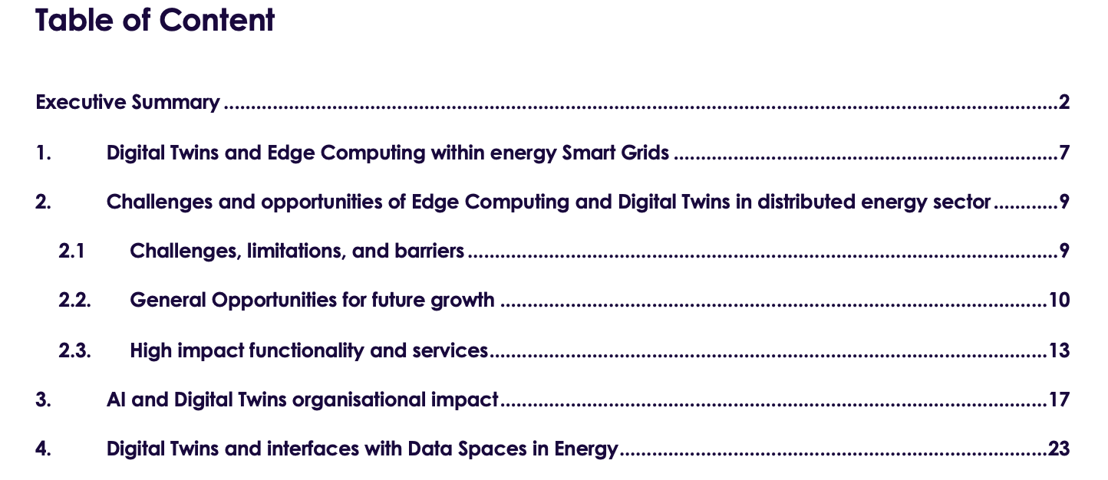
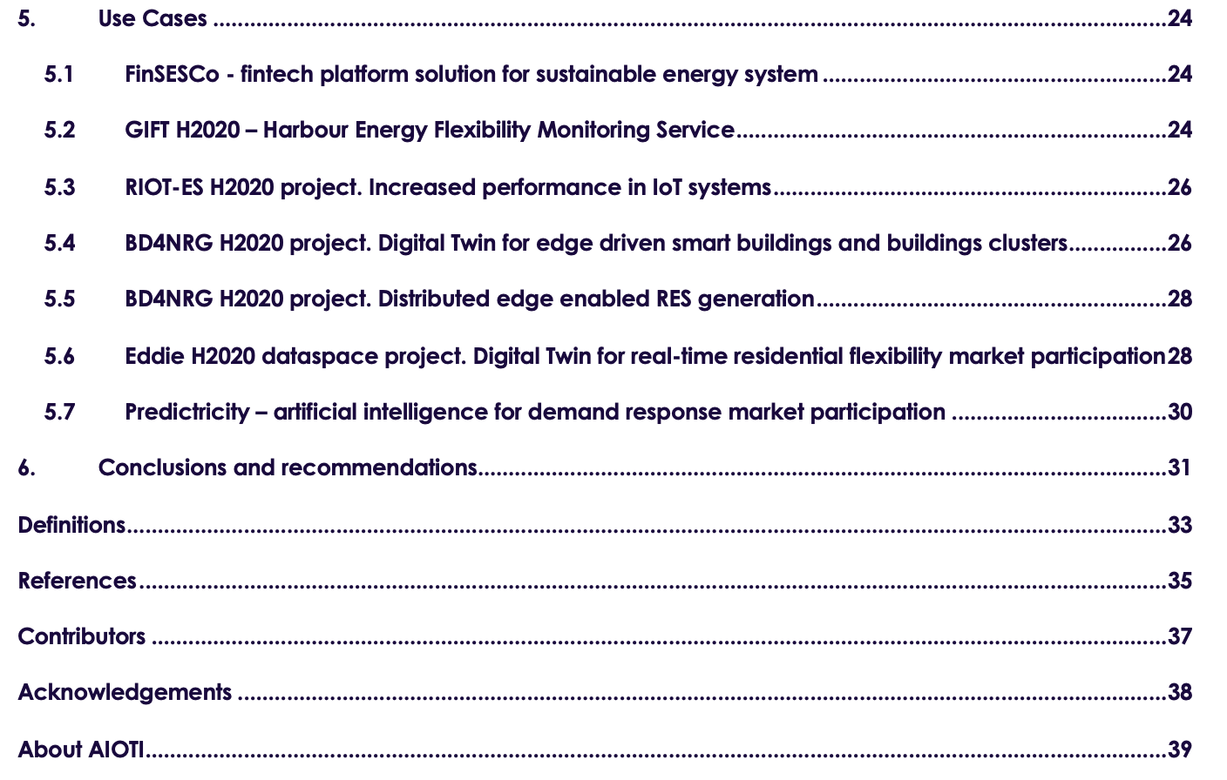
Edge driven Digital Twins in distributed energy systems
Report published on 31 January: https://aioti.eu/wp-content/uploads/2024/01/AIOTI-Edge-driven-Digital-Twins-in-distributed-energy-systems-Final.pdf

Slide 10
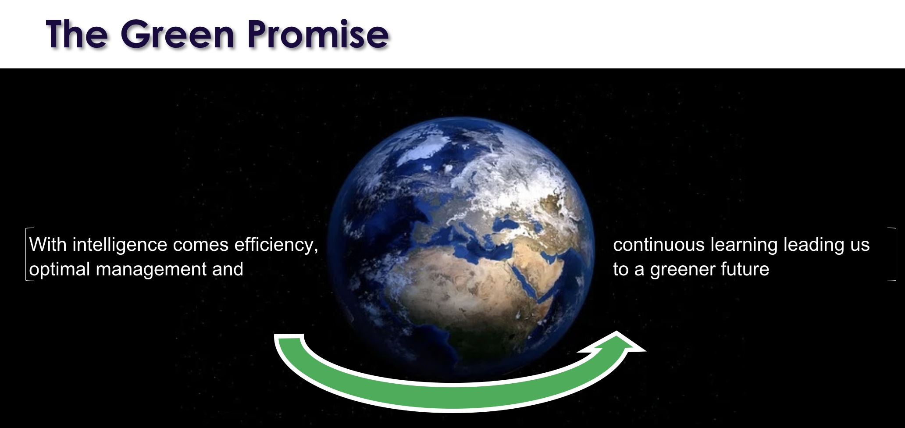
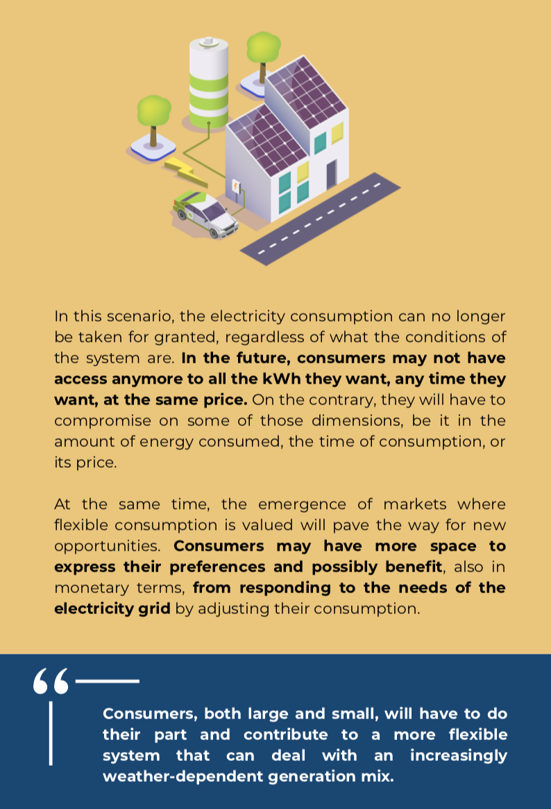
Digital Twins and Edge Computing within energy Smart Grids
Source: https://www.onenet-project.eu/wp-content/uploads/2024/03/Consumers-OneNet-1.pdf

Slide 11

Challenges and opportunities of Edge Computing and Digital Twins in distributed energy sector
Challenges
Shortage of digital skills in the energy sector
Regulatory issues
Opportunities for future growth
Data privacy and security concerns
Requiring innovative policies and regulatory experimentation (TEF, regulatory sandboxes)
AI and Digital Twins within the distributed scalability
Federated Digital Twins models
Linkage to the European Data Space
Optimisation and needs for determining useful data for collection
Technical maturity of digital twin technology
Lack of plug and play deployment tools
Source: https://www.onenet-project.eu/wp-content/uploads/2024/03/Consumers-OneNet-1.pdf
Notes:
Challenges:
Technical maturity of digital twin technology
Lack of plug and play deployment tools
Shortage of digital skills in the energy sector.
Regulatory issues:
Data privacy and security concerns
Requiring innovative policies and regulatory experimentation (TEF, regulatory sandboxes)
Opportunities for future growth:
The opportunities for uture growth in AI and Digital Twins within the distributed scalability,
Federated Digital Twins models,
Linkage to the European Data Space,
Optimisation and needs for determining useful data for collection.

Slide 12

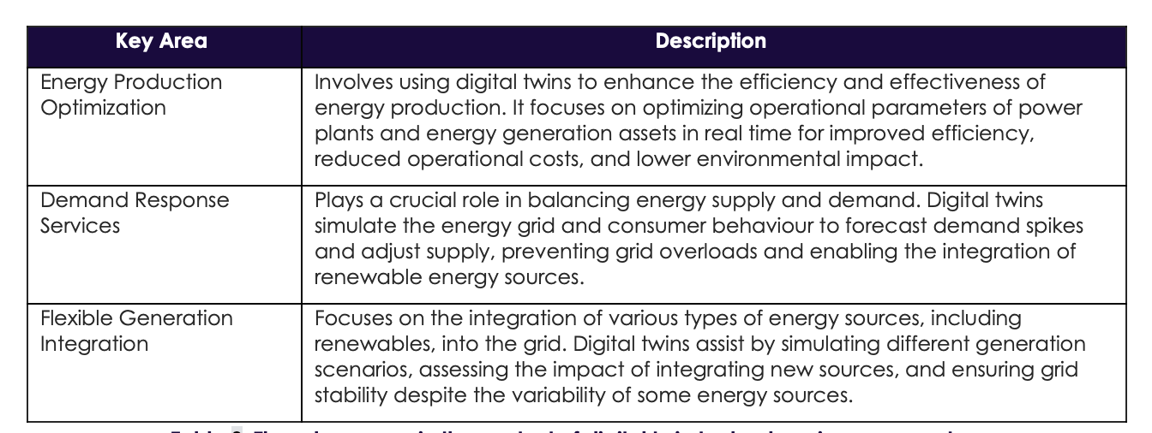
AI and Digital Twins organisational impact

Slide 13
Digital Twins and interfaces with Data Spaces in Energy
Real-time data synchronisation
Enhanced Decision Support through Simulation and Predictive Analysis
Establish smart environments: such as smart cities, smart buildings, and smart factories
The Digital Twin can be combined with other systems to create advanced human-machine interfaces
Data-Driven control in real time

Slide 14
Presentation of the use cases
Asbjorn Hovsto (Hafenstrom)
Ana Pereira (Ubiwhere)

Slide 15

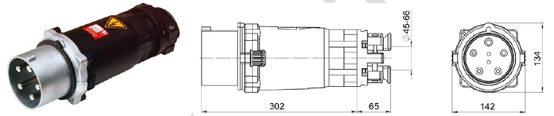
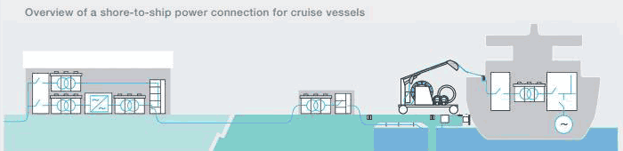
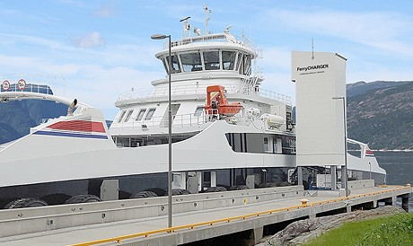
eFerry setup
EVC-EMC
Lack of support for Ferry2Grid from IEC standards
Main station
Power cables
Shorepower
substation
Quay
On-board installation
200 kW
22 kV
Main grid
133 kW
Consumption
532 kW
Actual battery capacity
Notes:
This is the landside setup – station connected to grid – substation providing energy to the charger – which is connected to the e-ferry
Magic happens – ferry EMS connected on docking - communication between e-ferry and landside – battery status, consumption profile based on stages in route (manouvering from quay, accelerating, transit, decelerating, manouvering to quay, docking – different consumption based on propulsion, hull, load etc.)
Will talk about standards in a short while – challenge with protocols and energy capacity whith relates to how quickly a battery can be charged
Battery size depends on technology, life cycle, state, overhead, load balancing and a number of other parameters
Required on-board battery capacity estimated to be 133 kWh – this is what normally be consumed
Actual battery size required to be installed is estimated to be 532 kWh
Minimum charging infrastructure at each quay equivalent to 0.8 MW

Slide 16
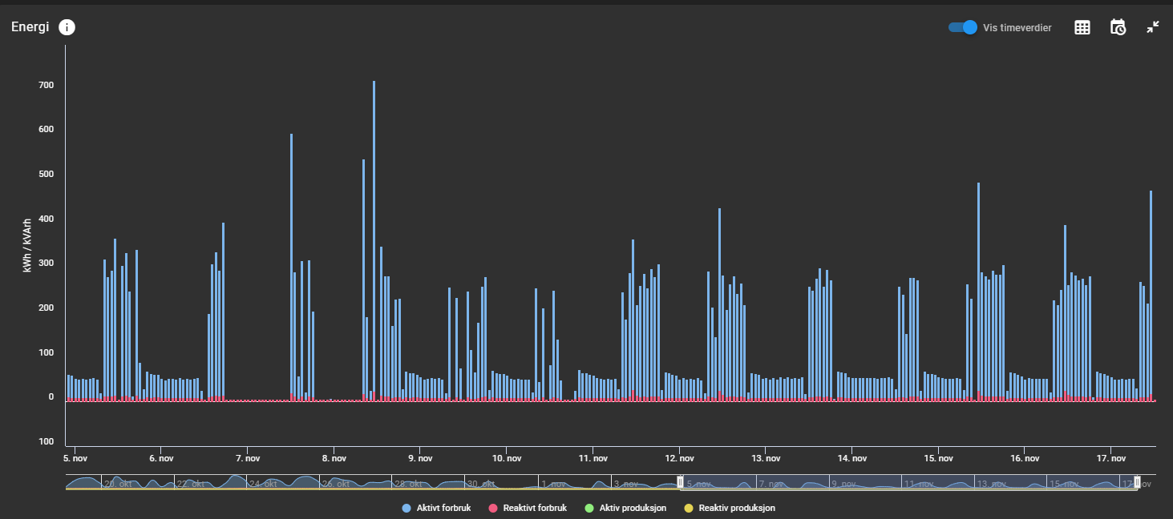
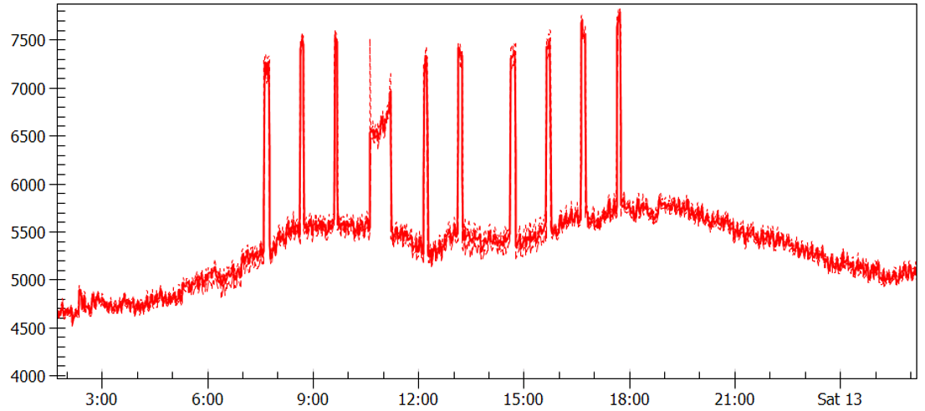
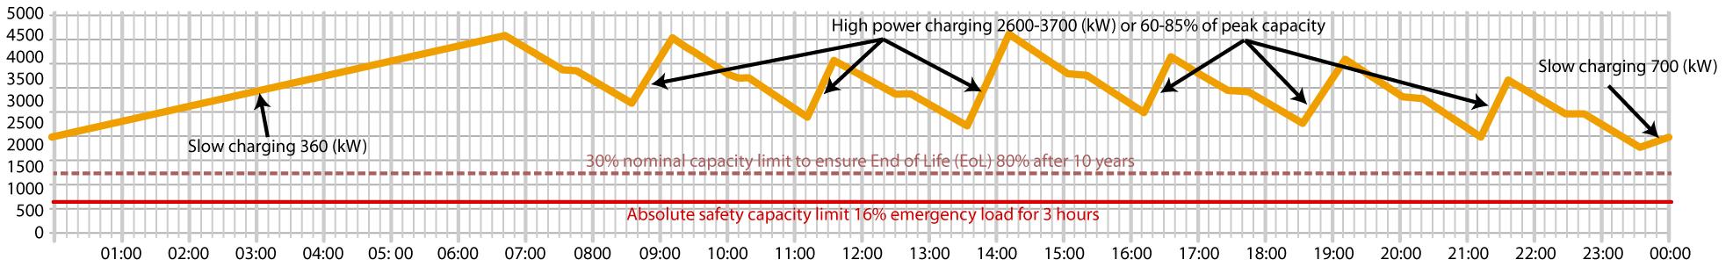
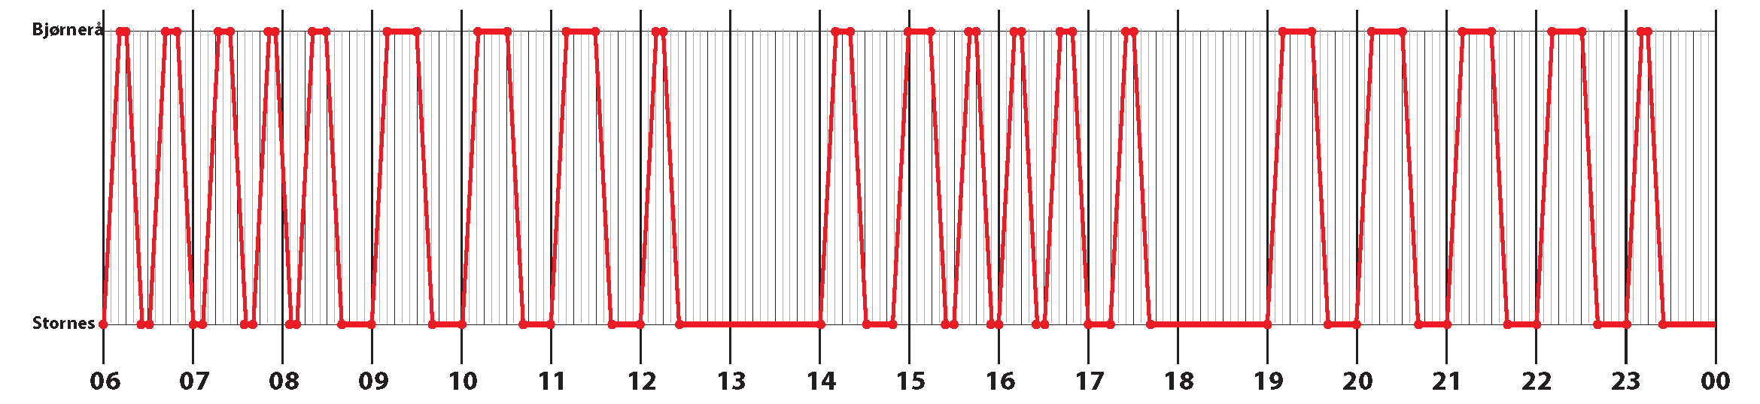
Effect on local powergrid on arrival
2 MW eFerry charging Edøya (Smøla)
eFerry flexibility: arrival, lay overtime and departure
time | time | time | time | time | kWh | kWh | kWh | kWh | kWh | time
Dep | Arr | Dep | Arr | Lay | Lay | Charg | Charg | Cons up to dep | Cons up to arr | Flex
Stornes | Bjørnerå | Bjørnerå | Stornes | Bjørnerå | Stornes | Bjørnerå | Stornes | Bjørnerå | Stornes | length
Weekdays
06:00 | 06:12 | 06:15 | 06:27 | 00:03 |  | 0,00 |  | 197,00 |  | 00:00
06:30 | 06:42 | 06:50 | 07:02 | 00:08 | 00:03 | 0,00 | 0,40 | 247,00 | 364,00 | 00:00
07:05 | 07:17 | 07:24 | 07:36 | 00:07 | 00:03 | 0,00 | 0,40 | 237,00 | 414,00 | 00:00
07:40 | 07:52 | 07:55 | 08:07 | 00:03 | 00:04 | 0,00 | 0,80 | 197,00 | 404,00 | 00:00
08:10 | 08:22 | 08:30 | 08:42 | 00:08 | 00:03 | 0,00 | 0,40 | 247,00 | 364,00 | 00:00
09:00 | 09:12 | 09:30 | 09:42 | 00:18 | 00:18 | 0,00 | 6,40 | 347,00 | 414,00 | 00:42
10:00 | 10:12 | 10:30 | 10:42 | 00:18 | 00:18 | 0,00 | 6,40 | 347,00 | 514,00 | 00:42
11:00 | 11:12 | 11:30 | 11:42 | 00:18 | 00:18 | 0,00 | 6,40 | 347,00 | 514,00 | 00:42
12:00 | 12:12 | 12:15 | 12:27 | 00:03 | 00:18 | 0,00 | 6,40 | 197,00 | 514,00 | 00:27
14:00 | 14:12 | 14:20 | 14:32 | 00:08 | 01:33 | 0,00 | 36,40 | 247,00 | 364,00 | 00:32
14:50 | 15:02 | 15:15 | 15:27 | 00:13 | 00:18 | 0,00 | 6,40 | 297,00 | 414,00 | 00:37
15:30 | 15:42 | 15:45 | 15:57 | 00:03 | 00:03 | 0,00 | 0,40 | 197,00 | 464,00 | 00:00
16:00 | 16:12 | 16:15 | 16:27 | 00:03 | 00:03 | 0,00 | 0,40 | 197,00 | 364,00 | 00:00
16:30 | 16:42 | 16:50 | 17:02 | 00:08 | 00:03 | 0,00 | 0,40 | 247,00 | 364,00 | 00:00
17:15 | 17:27 | 17:30 | 17:42 | 00:03 | 00:13 | 0,00 | 4,40 | 197,00 | 414,00 | 00:00
19:00 | 19:12 | 19:30 | 19:42 | 00:18 | 01:18 | 0,00 | 30,40 | 347,00 | 364,00 | 00:42
20:00 | 20:12 | 20:30 | 20:42 | 00:18 | 00:18 | 0,00 | 6,40 | 347,00 | 514,00 | 00:42
21:00 | 21:12 | 21:30 | 21:42 | 00:18 | 00:18 | 0,00 | 6,40 | 347,00 | 514,00 | 00:42
22:00 | 22:12 | 22:30 | 22:42 | 00:18 | 00:18 | 0,00 | 6,40 | 347,00 | 514,00 | 00:42
23:00 | 23:12 | 23:15 | 23:27 | 00:03 | 00:18 | 0,00 | 6,40 | 197,00 | 514,00 | 00:27
 |  |  |  |  | 06:33 |  | 13404,40 |  | 364,00 | 00:00
 |  |  |  |  |  | Total charging | 13536,40 | Total consumption | 8670,00 | 4866,40
Energy balance battery pack 24 hours (kWh)
Graph timeschedule
Notes:
Ferry is not needed for test models, solution developed anyway, graphs from harbours aligns with EEXI calculations.
Load profiles generated from route tables and measured energy consumption when being docked confirm expected state of charge/discharged

Slide 17

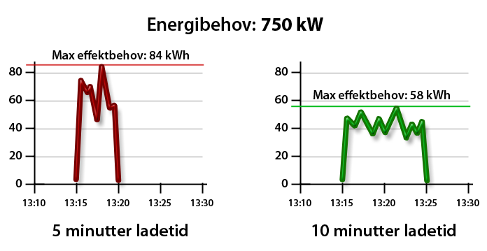
POWER PEAKS AND COORDINATION
Electrical ferries cannot offer surplus energy
However, elctrical ferries can offer power flexibility during layover
Longer layover means more power flexibility
Coordination of charging with timetables increase power flexibility
Energy demand: 750 kW
Max power demand: 84 kWh
Max power demand: 58 kWh
LIGGETID
Charging for 5 minutes
Layover
Charging for 10 minutes

Slide 18
TIMESCHEDULE AND MEASUREMENTS
time | time | time | time | time | kWh | kWh | kWh | kWh | kWh | time
Dep | Arr | Dep | Arr | Lay | Lay | Charg | Charg | Cons up to dep | Cons up to arr | Flex
Stornes | Bjørnerå | Bjørnerå | Stornes | Bjørnerå | Stornes | Bjørnerå | Stornes | Bjørnerå | Stornes | length
Weekdays
06:00 | 06:12 | 06:15 | 06:27 | 00:03 |  | 0,00 |  | 197,00 |  | 00:00
06:30 | 06:42 | 06:50 | 07:02 | 00:08 | 00:03 | 0,00 | 0,40 | 247,00 | 364,00 | 00:00
07:05 | 07:17 | 07:24 | 07:36 | 00:07 | 00:03 | 0,00 | 0,40 | 237,00 | 414,00 | 00:00
07:40 | 07:52 | 07:55 | 08:07 | 00:03 | 00:04 | 0,00 | 0,80 | 197,00 | 404,00 | 00:00
08:10 | 08:22 | 08:30 | 08:42 | 00:08 | 00:03 | 0,00 | 0,40 | 247,00 | 364,00 | 00:00
09:00 | 09:12 | 09:30 | 09:42 | 00:18 | 00:18 | 0,00 | 6,40 | 347,00 | 414,00 | 00:42
10:00 | 10:12 | 10:30 | 10:42 | 00:18 | 00:18 | 0,00 | 6,40 | 347,00 | 514,00 | 00:42
11:00 | 11:12 | 11:30 | 11:42 | 00:18 | 00:18 | 0,00 | 6,40 | 347,00 | 514,00 | 00:42
12:00 | 12:12 | 12:15 | 12:27 | 00:03 | 00:18 | 0,00 | 6,40 | 197,00 | 514,00 | 00:27
14:00 | 14:12 | 14:20 | 14:32 | 00:08 | 01:33 | 0,00 | 36,40 | 247,00 | 364,00 | 00:32
14:50 | 15:02 | 15:15 | 15:27 | 00:13 | 00:18 | 0,00 | 6,40 | 297,00 | 414,00 | 00:37
15:30 | 15:42 | 15:45 | 15:57 | 00:03 | 00:03 | 0,00 | 0,40 | 197,00 | 464,00 | 00:00
16:00 | 16:12 | 16:15 | 16:27 | 00:03 | 00:03 | 0,00 | 0,40 | 197,00 | 364,00 | 00:00
16:30 | 16:42 | 16:50 | 17:02 | 00:08 | 00:03 | 0,00 | 0,40 | 247,00 | 364,00 | 00:00
17:15 | 17:27 | 17:30 | 17:42 | 00:03 | 00:13 | 0,00 | 4,40 | 197,00 | 414,00 | 00:00
19:00 | 19:12 | 19:30 | 19:42 | 00:18 | 01:18 | 0,00 | 30,40 | 347,00 | 364,00 | 00:42
20:00 | 20:12 | 20:30 | 20:42 | 00:18 | 00:18 | 0,00 | 6,40 | 347,00 | 514,00 | 00:42
21:00 | 21:12 | 21:30 | 21:42 | 00:18 | 00:18 | 0,00 | 6,40 | 347,00 | 514,00 | 00:42
22:00 | 22:12 | 22:30 | 22:42 | 00:18 | 00:18 | 0,00 | 6,40 | 347,00 | 514,00 | 00:42
23:00 | 23:12 | 23:15 | 23:27 | 00:03 | 00:18 | 0,00 | 6,40 | 197,00 | 514,00 | 00:27
 |  |  |  |  | 06:33 |  | 13404,40 |  | 364,00 | 00:00
 |  |  |  |  |  | Total charging | 13536,40 | Total consumption | 8670,00 | 4866,40
❶
❷
❸
❶
❷
❸

Slide 19









Electric devices
Appliances, streetlights, heaters etc.
E-ferry controlsystems
EMS: Energy Management System
Monitoring, planning, balancing onboard energy consumption
PMS: Power Management System
Controlling power system
BMS: Battery Management System
Balancing energy cells and consumption profile
Substation
Connected to weak powergrid
Electric vehicle
Public transport,
private car, bikes etc.
Ferry charger
Use OCPP for communication
EV charger
Support OCPP

Slide 20
Estimated layover for charging
Calculated grid capacity
Estimated consumption
Calculated energy flexibility demand and offer
On board battery and capacity
Route
table
Calculated available capacity
Ship and vessel configuration
Charger systems
Ports and harbour facilities
Quays and installations
Preparation
(based on order, position, status, availability, etc.)
Notes:
* Harbor EFM supports integration with a variety of charging systems - and is built to communicate with OCPP devices, future standards for energy management and smart charging points.
* Harbor EFM supports smart solutions for managing activation / control of charging points based on ship position, battery status, datasets received from sensors and other shore power systems.
* Harbor EFM offers integration with the European power grid and energy market through connection to INEA's VPS service
* Harbor EFM has been developed as part of the European-funded project GIFT - "Geographical Island Flexibility"

Slide 21
Challenges: Energy Efficient in IoT
Low energy efficiency in IoT systems
With the increasing number of IoT devices and complex IoT applications, these systems consume a significant amount of energy which makes its efficiency an important issue to address.
A number of efforts have been done to optimise the energy consumption in IoT. However, efforts done so far have focused on particular IoT applications, dedicated to particular scenarios.

Slide 22
Challenges: Performance in IoT
Low performance in IoT systems
IoT data is typically processed in the cloud in computing resources within data centres in different locations, causing higher latency and increased network load. Main challenges:
Integration between the IoT and cloud technologies
Provisioning & resource management for edge computing

Slide 23
Riot-ES Value Proposition and Innovation
RIOT-ES focuses on two dependable and complementary aspects of IoT systems: energy efficiency and performance.
Important goal of increasing the energy efficiency of IoT with important technical contributions independent of the particular applications and their specific conditions.
Aimed at designing and executing edge computing in its use cases in order to improve IoT performance.

Slide 24
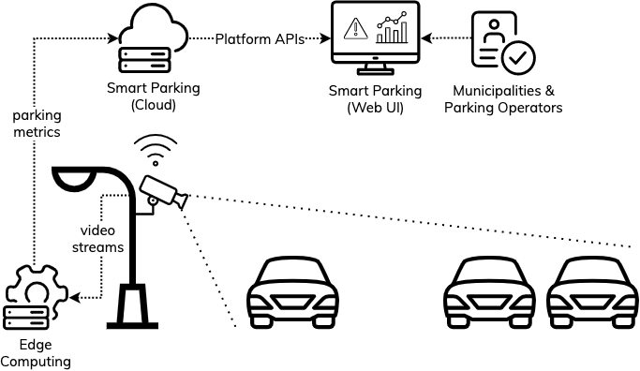
Smart Parking Use Case
Demonstration of the usage of video cameras and edge computing to monitor the real-time availability of parking spaces in areas.

Slide 25
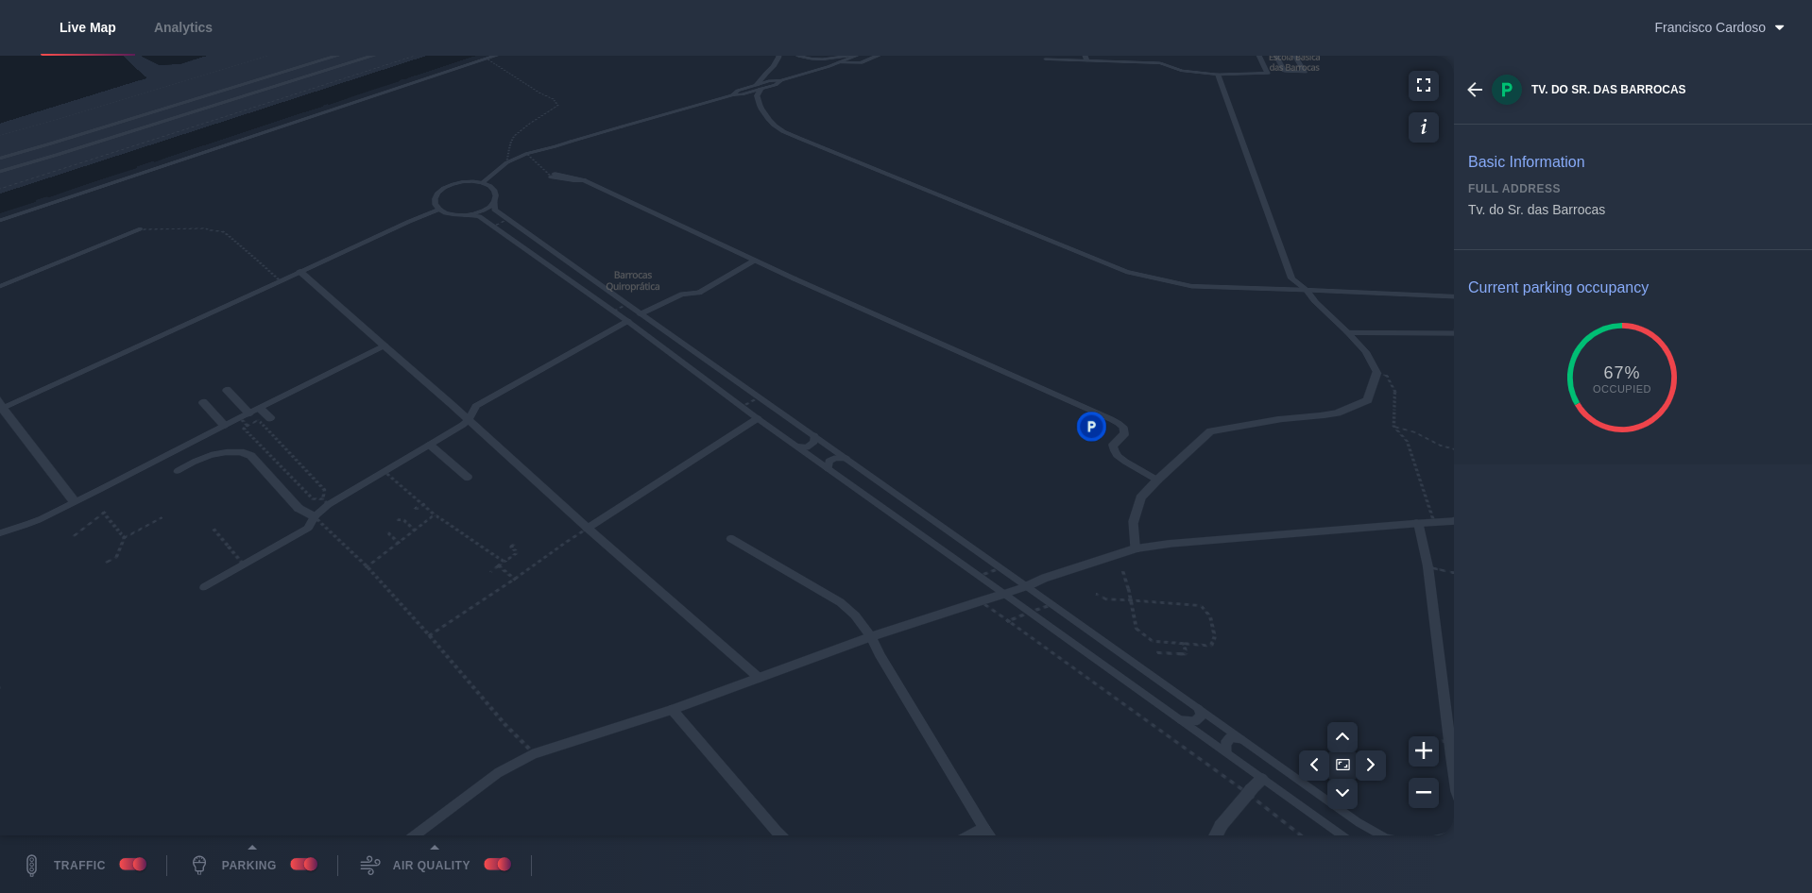


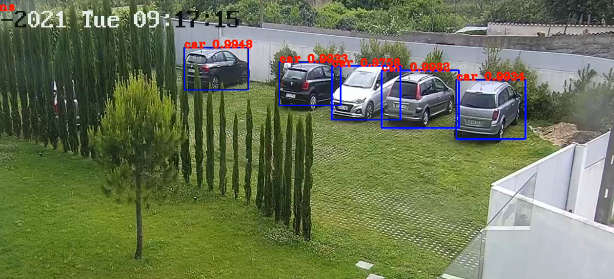
Smart Parking Use Case
Image Recognition
Video processed using image recognition software to get the real-time occupancy of each parking.
AI
Several computer vision models with different computing power used to achieve the lowest consumption.

Slide 26
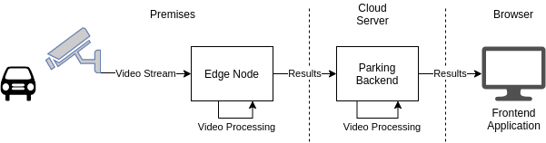
Smart Parking Demo
Parking data through video analytics:
Obtain parking occupancy with deep neural networks for object detection on the edge
Transfer information to the Smart Parking web application
Apply efficient methods and algorithms to improve the solution’s energy efficiency

Slide 27
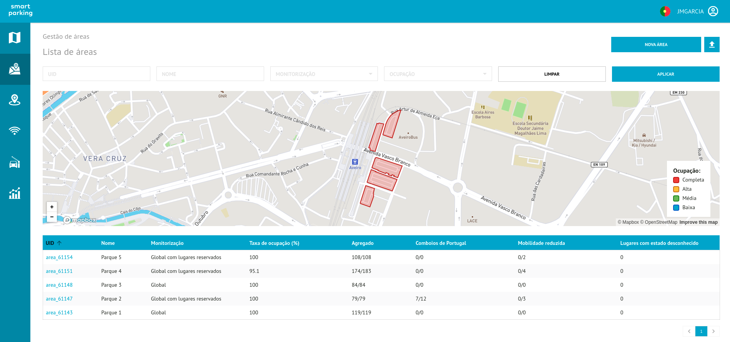
Smart Parking Demo

Slide 28
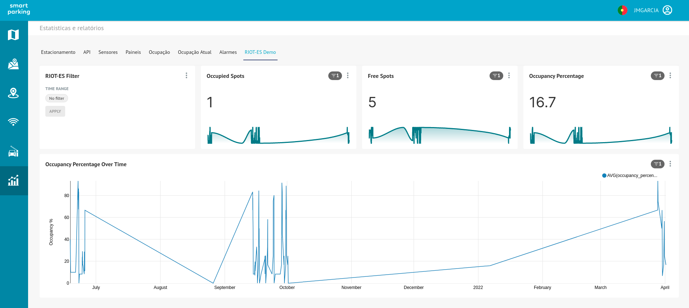
Smart Parking Demo

Slide 29
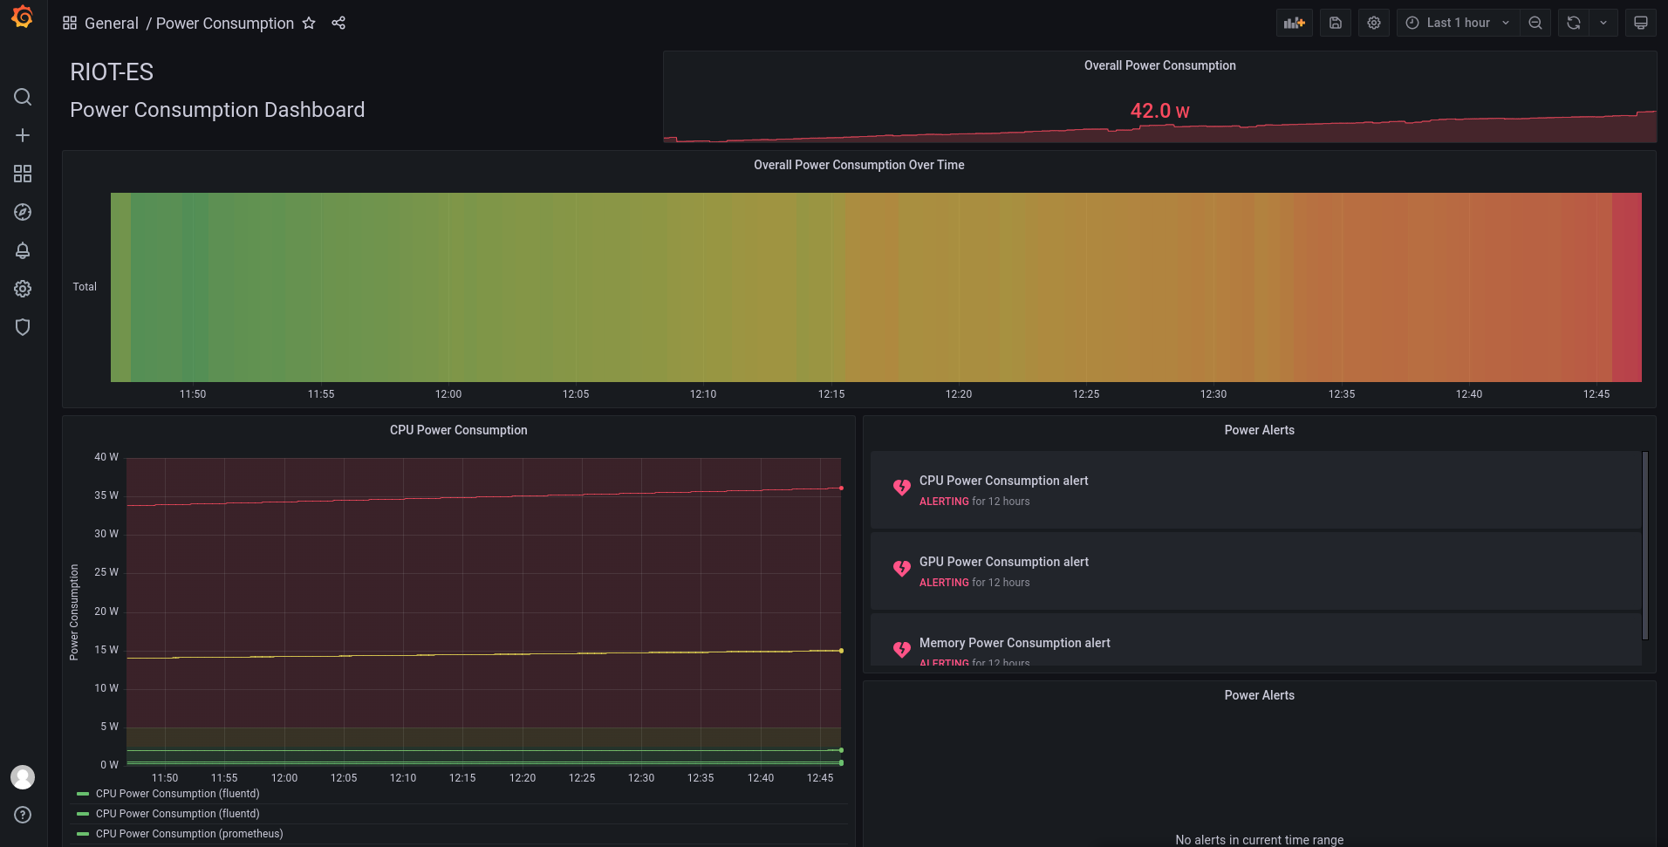
Smart Parking Demo

Slide 30
Presentation of the recommendations
Mays AL-Naday (University of Essex)
Ondrej Cerny (E.DSO)

Slide 31
Conclusions: considerations of digital twins
Energy footprint
Diverse services (particularly AI) , demand, connectivity
Diverse edge-to-cloud infrastructure
Comprehensive Modelling
Large number of parameters and constraints
Co-existence and dependency (e.g. cloud-network providers)
Autonomy of connected systems and variant information sharing
Multiple objectives (possibly conflicting) and trade-offs
Joint problems and their interplay
Addon resources and dependencies (e.g. data Ops)
Multiple Stakeholders
Not only consumption, but prices and source-type

Slide 32
Conclusions: Priority metrics
Infrastructure Energy
Power Utilization Efficiency (PUE) of edge-cloud DCs in similar climate
Energy Proportional computing (per cloud job)
Digital services
Volume and complexity of data produced by energy systems
Features' heterogeneity across different energy systems and interoperability
Restrictions on movability, QoS/QoE, and induced load on continuum resources
Characteristics (e.g. inter-service dependency), resource intensity
energy price, brown-green split, CO2 emissions
Data
Restrictions on data sharing across autonomous systems and stakeholders
Skills Gap
Technical and digital literacy in the energy sector (common practices)
DevOps increasingly integrating data and AI Ops

Slide 33
Recommendations: enabling factors
Regulation
Flexible regulation including supportive instruments (sandboxes etc)
Implementation on national level
EU cooperation
Coordinated implementation of digital twins
Sharing best practices
Digital skills
Developing capabilities in industry
Enhancing competences and understanding of policy makers and regulators
Important role of standardisation

Slide 34
Recommendations
Support further research
Regulatory flexibility
Enhance stakeholders’ capabilities
Advancing the maturity of the technology
Support cross-EU collaboration
Deliver best practices and learnings from implementation
Regulatory sandboxes and other instruments for testing impacts of digital twins
Enable the required investments
All actors should be included (industry, consumers, policy makers)
Enhance data standards
To cover the new used cases connected to grid edge and digital twins
Ensure interoperability, security and privacy of the shared data

Slide 35
Questions from the Audience
Moderated by:
Natalie Samovich, WG Energy Chair (Enercoutim)

Slide 36
Wrap up and end of the Webinar
Natalie Samovich, WG Energy Chair (Enercoutim)

Slide 37

Thank you for listening
Any questions?
You can find us at @AIOTI_EU or email sg@aioti.eu

